Slide 1

An inverted puzzle: a complex case of CRT in a congenitally corrected transposition of great vessels
Prémio Científico
Caso Clínico
Joana Lima Lopes | Nuno Cabanelas| Francisco Madeira
Serviço de Cardiologia

Slide 2

Case report PRESENTATION
56 years old female
Previous history:
- Hypertension
- Dyslipidemia
Smoking habits
Medication: sinvastatin 20mg, furosemide 80mg, esomeprazol 20mg
Sent to the ER due to:
Heart failure NYHA IV
ECG: complete atrioventricular block with heart rate 45bpm, a QRS <130ms

Slide 3

Case report INVESTIGATION
TTE: congenitally corrected transposition of great vessels (ccTGA) and a dextrocardia; suspicion of ventricular septal defect (VSD; severely depressed left ventricular function (ejection fraction < 30%)
Heart CT scan: confirmation of CCTGA and dextrocardia
TTE: Transthoracic echocardiography
CCTGA: congenitally corrected transposition of great vessels
VSD: ventricular septal defect
CT : computerized tomography

Slide 4
Case report INVESTIGATION
CCTGA:
Atrio-ventricular and ventriculo-arterial discordance
Spontaneous atrioventricular conduction disturbances
Progressive HF is one of the leading causes of mortality
CRT has gained increasing momentum
CCTGA: congenitally corrected transposition of great vessels
CRT: cardiac resynchronization therapy
Levine, Glenn N., Color Atlas of cardiovascular disease, chapter 44, 2015

Slide 5
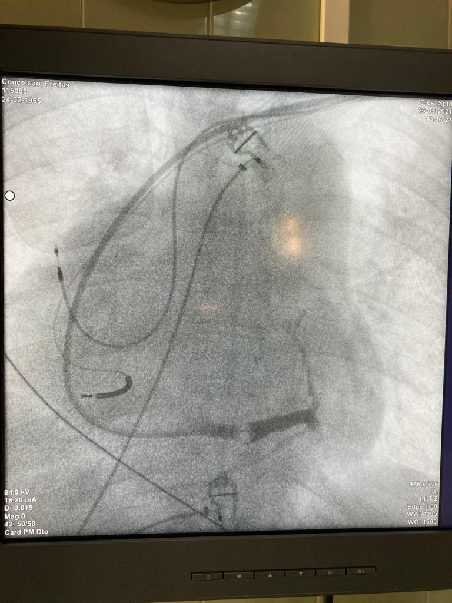
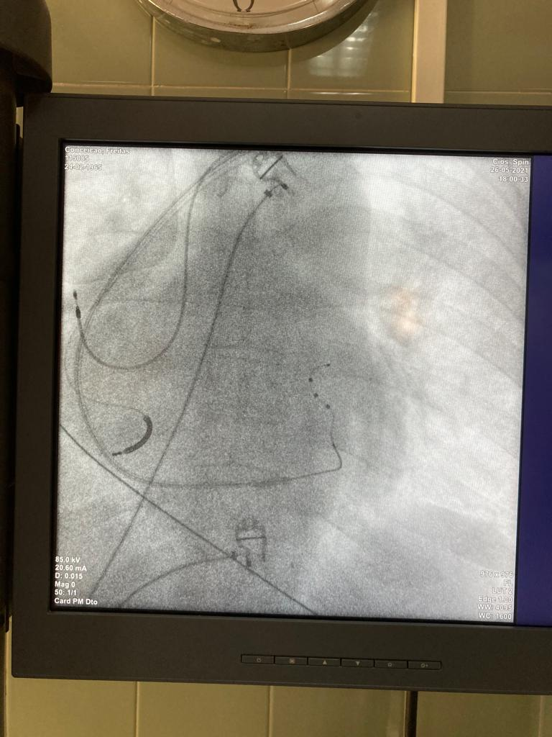
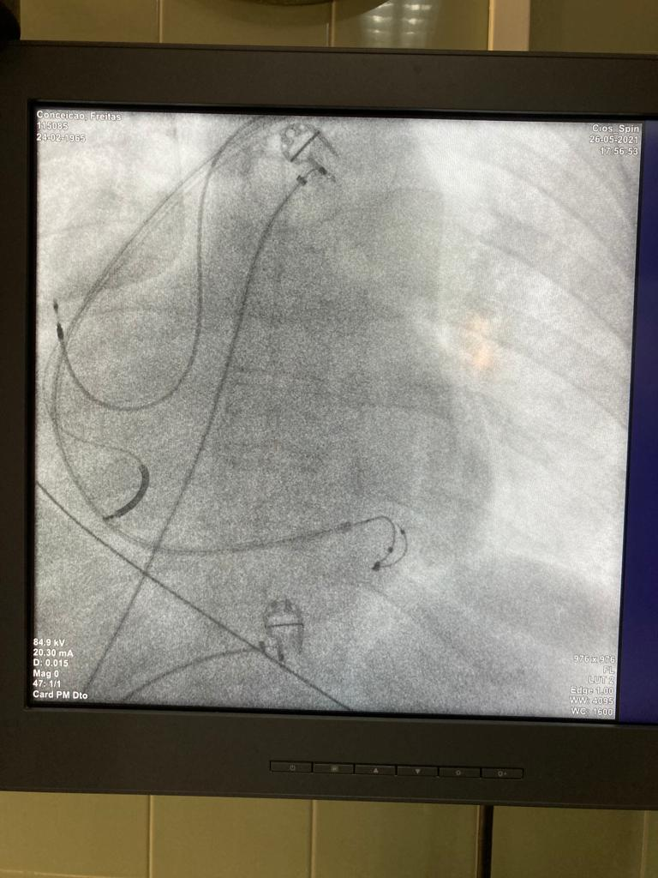
Case report MANAGEMENT
cAVB + severe LV disfunction: a CRT-D was proposed for implantation
cAVB: complete atrioventricular block
LV: Left ventricule
CRT-D: cardiac resynchronization therapy with defibrillator

Slide 6
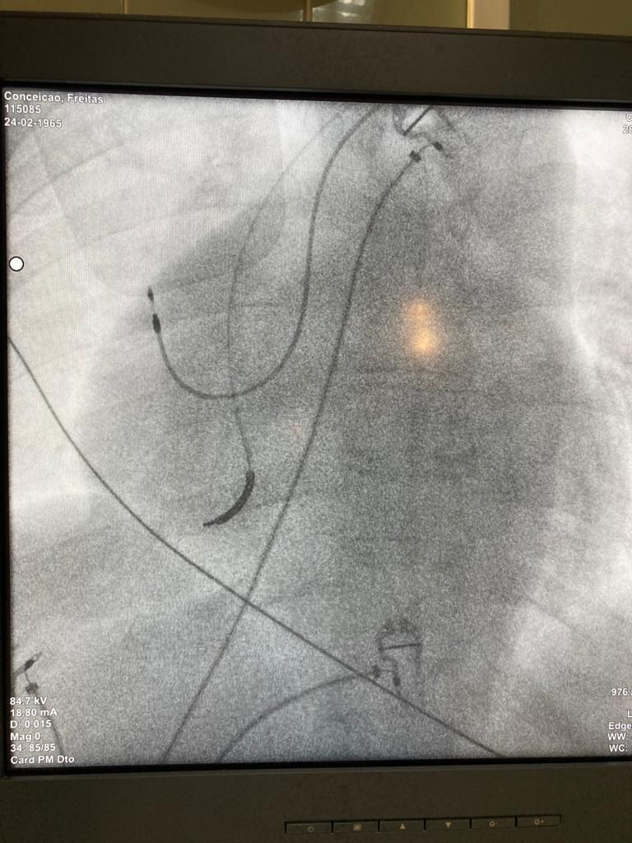
Case report MANAGEMENT
No capture tresholds with the CRT-D, probably justified by the fibrotic tissue present in a highly remodeled ventricule
CRT-D was removed and a dual chamber ICD was placed instead
CRT-D: cardiac resynchronization therapy with defibrillator
ICD: implantable cardiac defibrillator

Slide 7
LEARNING OUTCOMES
Although challenging, a CRT placement is possible in a CCTGA
In spite of the evidence favoring CRT placement for quality of life improvement in congenital patients, whether the heart’s fibrotic tissue will allow adequate capture thresholds is unknown
CCTGA: congenitally corrected transposition of great vessels

Slide 8

OBRIGADO
Joana Lima Lopes
30/01/2024

