Slide 1

Wilson’s Disease
first report of two combined mutational variants in a Portuguese patient

Slide 2
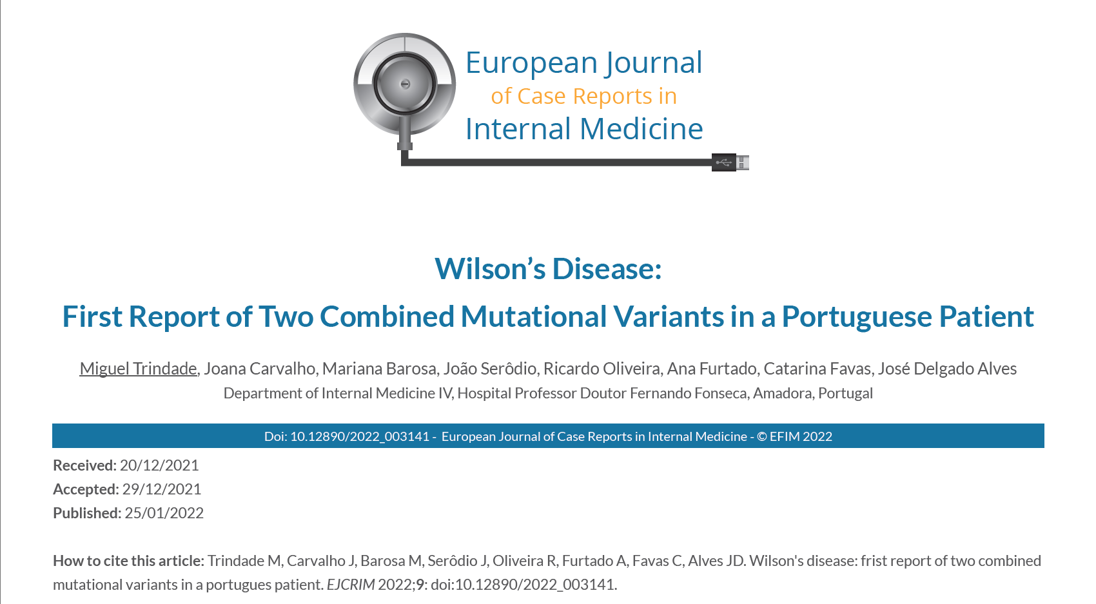
Case Report

Slide 3
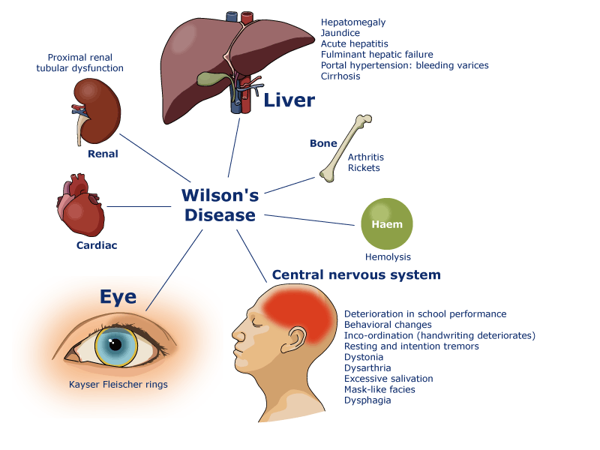
Introduction
Wilson's disease (WD) is a rare autosomal recessive disease with a prevalence of 1 to 30000¹
A defect in the copper carrier protein ATP7B prevents copper excretion, which then accumulates in several organs, notably in the liver, cornea, and central nervous system
The prognosis of Wilson's disease is favorable if the diagnosis is made early
The Leipzig diagnostic criteria standardized the diagnostic approach for WD
Adaptado de www.eurowilson.org
¹Merle U, 2007

Slide 4
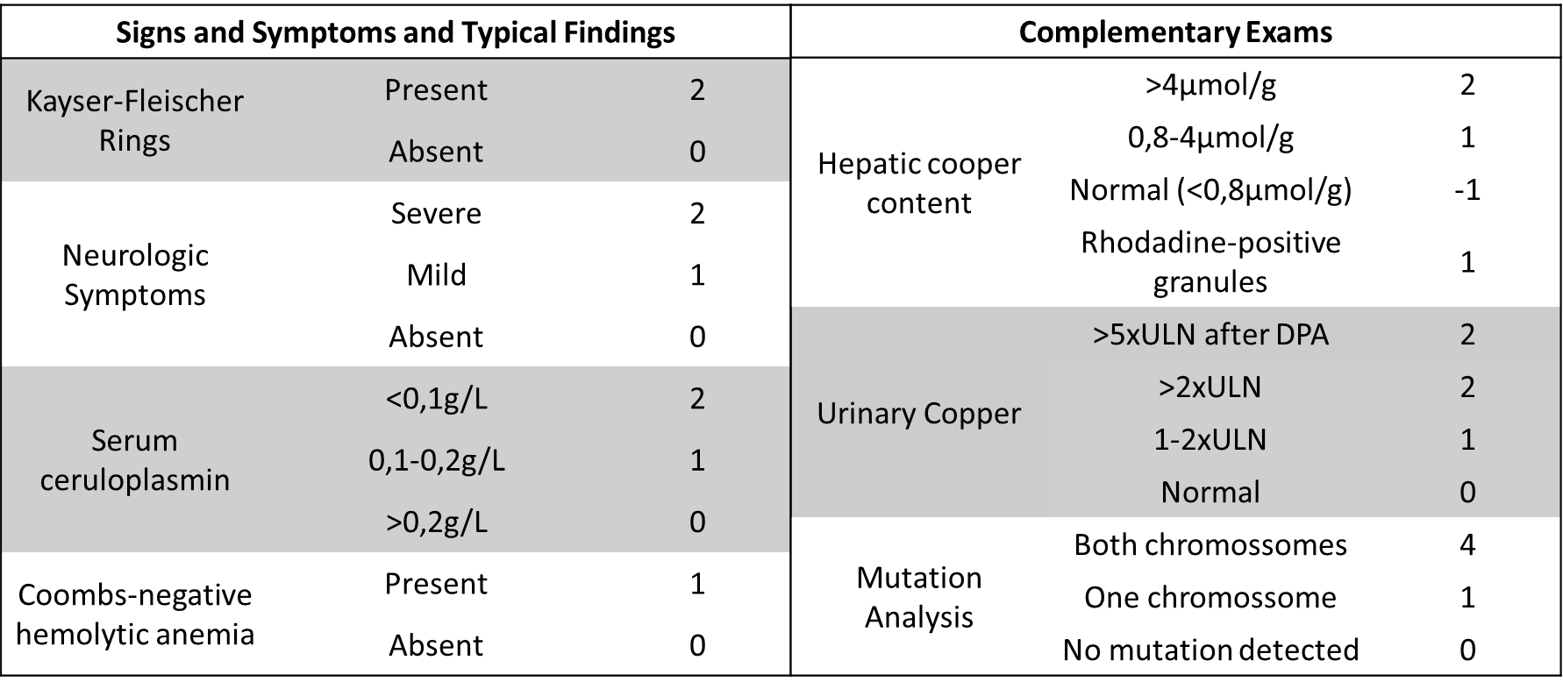
Introduction
Wilson's disease (WD) is a rare autosomal recessive disease with a prevalence of 1 to 30000¹
A defect in the copper carrier protein ATP7B prevents copper excretion, which then accumulates in several organs, notably in the liver, cornea, and central nervous system
The prognosis of Wilson's disease is favorable if the diagnosis is made early
The Leipzig diagnostic criteria standardized the diagnostic approach for WD
Table 1: Leipzig score, adapted from the 8th International Meeting on Wilson’s disease, Leipzig 2001: score ≥4 diagnosis established, score =3 diagnosis possible, but more tests needed and score ≤2 diagnosis very unlikely. ULN: upper limit normal, DPA: D-Penicillamine
¹Merle U, 2007

Slide 5
Case Description
Identification: 24-year-old portuguese caucasian woman with no previous medical history, relevant family history or medication
Presentation and physical exam: Symmetric palpebral and lower limb edema and choluria for one month. Palpable hepatomegaly.
Laboratory results: elevated transaminases (3-4xUNL), hyperbilirubinemia, hypoalbuminemia and severe coagulopathy; hypokalemia, hypophosphatemia, hypouricemia
Imagiology exams: abdominal ultrasound and CT showed homogeneous hepatomegaly with umbilical vein permeabilization.
Chronic liver disease differential diagnosis: negative serologies for the hepatotropic viruses and liver autoimmunity markers, normal alfa-1 antitrypsin, low ceruloplasmin (4mg/dL; N 20-35mg/dL) > Trientine was started
Table 1: Laboratory results

Slide 6
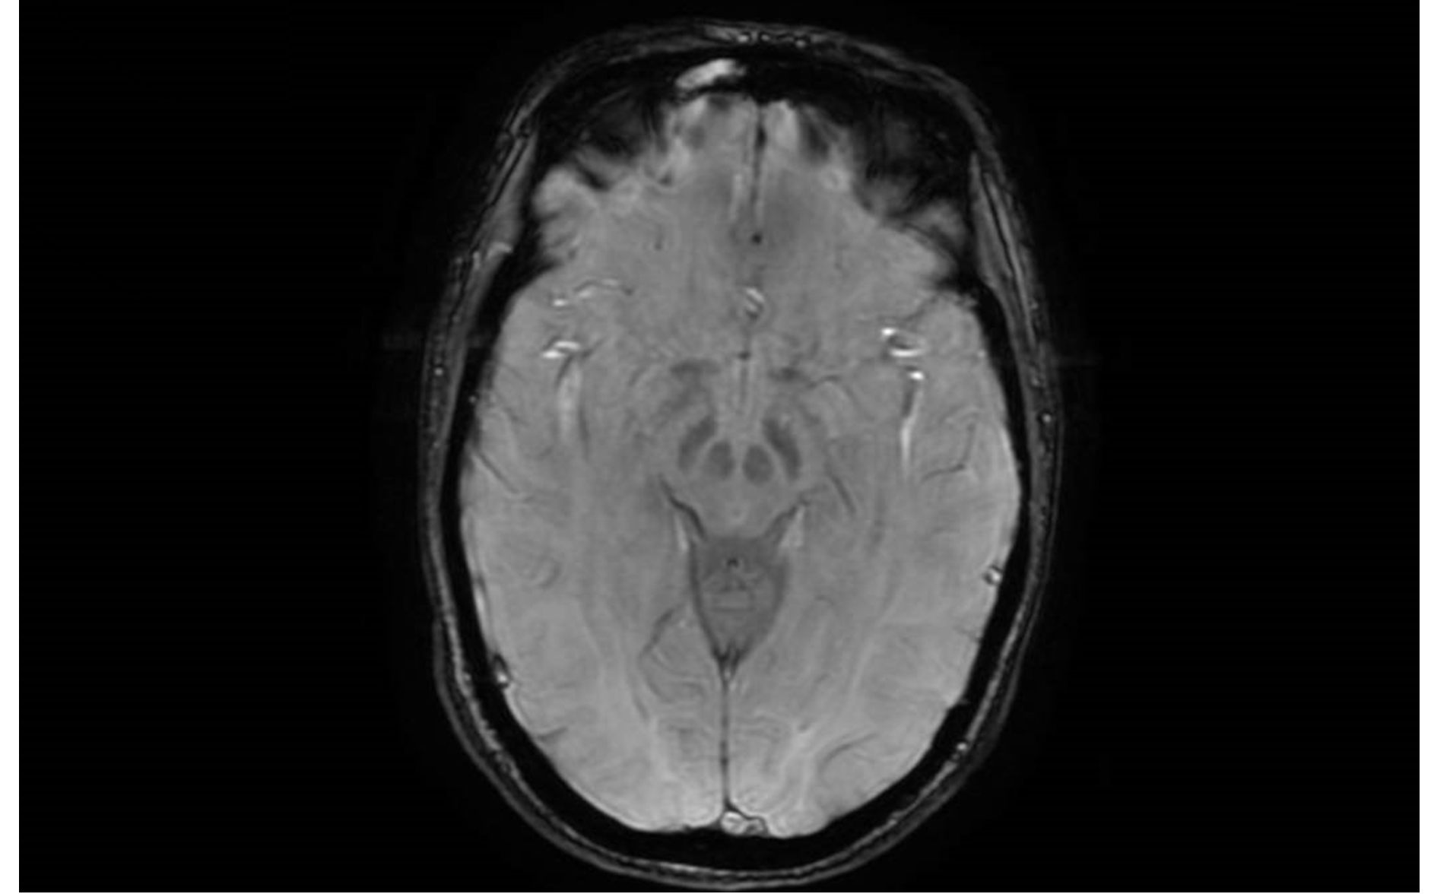
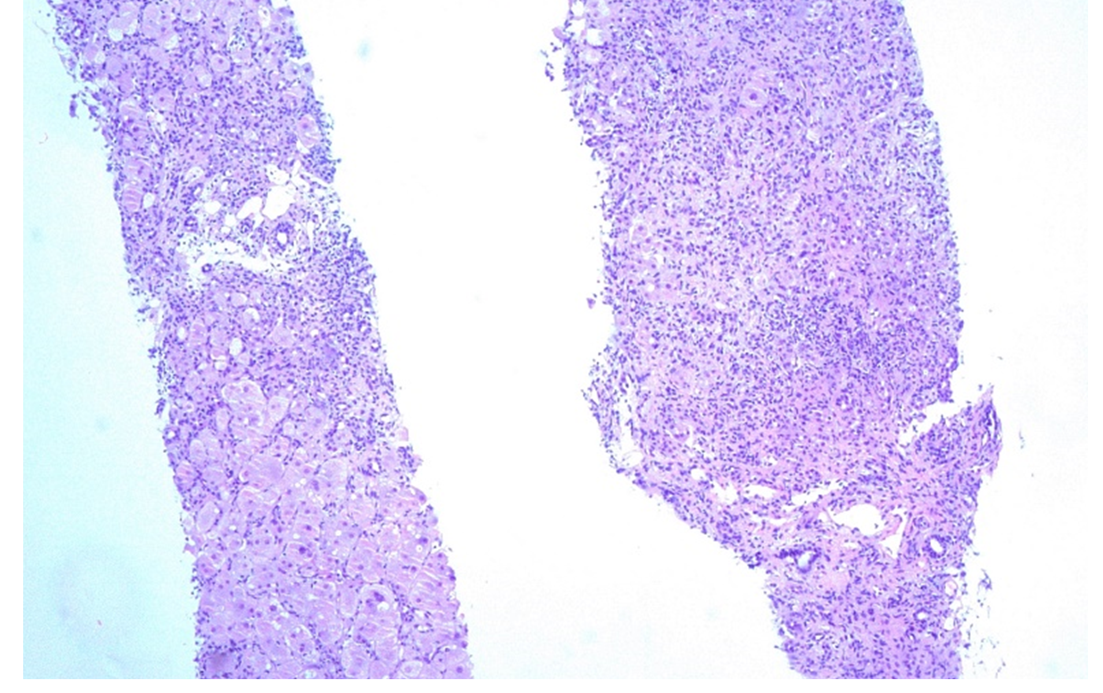
Case Description
Wilson´s disease workup: increased urinary copper (3840mcg/24h; N 20-50mcg/24h), no Kaiser-Fleischer rings, brain MRI showed bilateral high T2 signal in the red nucleus and substantia (figure 1), liver biopsy showed acute hepatocellular injury without evidence of copper pigment deposition (figure 2)
Insufficient criteria for Wilson’s disease diagnosis
Figure 1. Bilateral high signal in the red nucleus and substantia nigra consistent with the panda sign of the midbrain, classically seen in Wilson disease (T2-SWAN)
Table 2: Leipzig score, adapted from the 8th International Meeting on Wilson’s disease, Leipzig 2001(2): score ≥4 diagnosis established, score =3 diagnosis possible, but more tests are needed, and a score ≤2 diagnosis is very unlikely. ULN: upper limit normal, DPA: D-Penicillamine
Figure 2. Acute hepatocellular injury with confluent necrosis, portal fibrosis, extensive lymphocytic inflammatory infiltrate and no evidence of copper pigment deposition (haematoxylin-eosin ×50)

Slide 7
Case Description
Molecular study: reported pathogenic mutations in the ATP7B gene in compound heterozygosity:
  c.3402del – frameshift mutation, pathologic variant; most common mutation in Brazil and Venezuela (common portuguese ancestry reported)²⁻⁴
  c.3061-12T>A – splicing error with a premature stop, likely pathogenic, neurologic disease, two French reports (with Portuguese ancestry) and a Portuguese pediatric report⁵⁻⁸
Criteria met for Wilson’s disease diagnosis – Leipzig score (LS) >4
Immediate Follow-Up: the patient was transferred to a liver transplant center (Hospital Curry Cabral) - factor V reached a minimum of 15% partially fulfilling Clichy criteria but no King’s College criteria were met. Fortunately, our patient improved with medical therapy, and intervention was not necessary.
Table 2: Leipzig score, adapted from the 8th International Meeting on Wilson’s disease, Leipzig 2001(2): score ≥4 diagnosis established, score =3 diagnosis possible, but more tests are needed, and a score ≤2 diagnosis is very unlikely. ULN: upper limit normal, DPA: D-Penicillamine
²Deguti MM, 2004 ³ De Bem RS, 2013, ⁴ Paradisi, 2015, ⁵ Loudianos, 2002, ⁶ Dufernez, 2013 ⁷ Couchonnal, 2021 ⁸ Silva, 2011

Slide 8
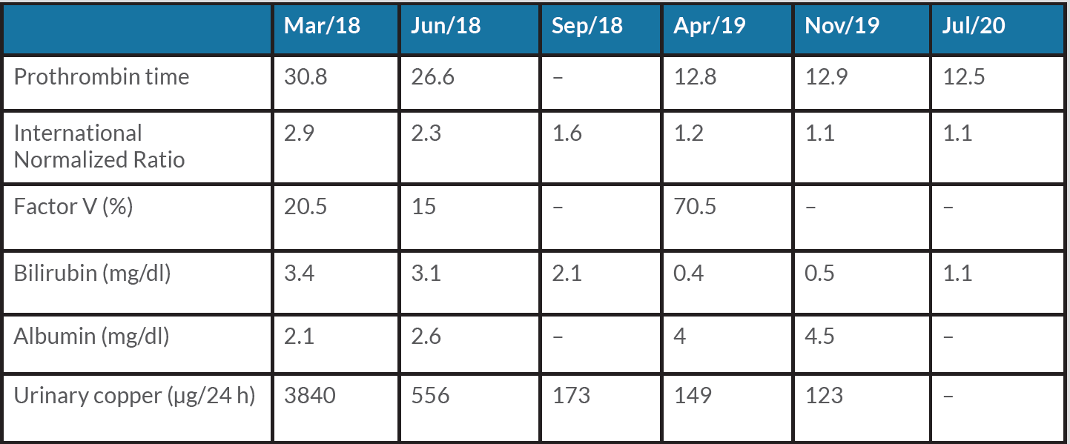
Case Description
Long-term Follow-up: Uneventful, with a progressive improvement of the liver function (Table 3). A mild tremor was reported but without interference in daily activities and did not require a specific medical treatment.
“Three years after the diagnosis, the patient is well with no clinical symptoms and complete recovery of liver function tests while maintaining the cooper chelating therapy” (2021)
Table 3: Laboratory results in follow-up

Slide 9
Discussion
WD is rare, and the diagnostic suspicion should be high in young patients with subacute or acute chronic liver disease: a diagnosis made in time can avoid a liver transplant.
The diagnostic workup was not straightforward, and genetic testing was necessary to confirm the diagnosis
To our knowledge, this is the first report of this compound heterozygote genotype.
  The c.3402del mutation has been described as liver-predominant in heterozygous and neurologically predominant in homozygous patients.
  The c.3061-12T>A mutation is described as neurologically predominant.
The evolution of our patient remains to be seen in the long-term follow-up.
Adaptado de www.eurowilson.org

Slide 10
Final Diagnosis
Wilson’s Disease

Slide 11
Acknowledgments
Dra. Adelaide Milheiro (Serviço de Anatomia Patológica, Hospital Curry Cabral) for collecting and sharing the liver biopsy images.

Slide 12
References
1 - Merle U, Schaefer M, Ferenci P, Stremmel W. Clinical presentation, diagnosis and long-term outcome of Wilson’s disease: a cohort study. Gut 2007;56(1):115–120
2 - Deguti MM, Genschel J, Cancado EL, Barbosa ER, Bochow B, Mucenic M, et al. Wilson disease: novel mutations in the ATP7B gene and clinical correlation in Brazilian patients. Hum Mutat. 2004;23(4):398.
3 - De Bem RS, Raskin S, Muzzillo DA, Deguti MM, Luiz E, Cançado R, et al. Wilson’s disease in Southern Brazil : genotype-phenotype correlation and description of two novel mutations in ATP7B gene. Arq Neuropsiquiatr 2013;71(8):503–507
4 - Paradisi I, De Freitas L, Arias S. Most frequent mutation c.3402delC (p.Ala1135GlnfsX13) among Wilson disease patients in Venezuela has a wide distribution and two old origins. Eur J Med Genet 2015;58(2):59–65
5 - Loudianos G, Lovicu M, Dessi V, Tzetis M, Kanavakis E, Zancan L, et al. Abnormal mRNA splicing resulting from consensus sequence splicing mutations of ATP7B. Hum Mutat. 2002;20(4):260–266.
6 - Dufernez F, Lachaux A, Chappuis P, De Lumley L, Bost M, Woimant F, et al. Wilson disease in offspring of affected patients: report of four French families. Clin Res Hepatol Gastroenterol 2013;37(3):240–245.
7 - Couchonnal E, Bouchard S, Sandahl TD, Pagan C, Lion-François L, Guillaud O, et al. ATP7B variant spectrum in a French pediatric Wilson disease cohort. Eur J Med Genet. 2021 Oct;64(10):104305. Erratum in: Eur J Med Genet. 2021 Nov;64(11):104341
8 - Silva F, Nobre S, Campos AP, Vasconcelos M, Gonçalves I. Behavioural and psychiatric disorders in paediatric Wilson’s disease. BMJ Case Rep 2011;2011:4–7.

