Slide 1
8-ZONE LUNG ULTRASOUND AND BIOIMPEDANCE ANALYSIS FOR ASSESSMENT OF HYDRATION STATUS IN HEMODIALYSIS
Andreia Curto, Pedro Campos, Mariana Ramos, Inês Alexandre, Ana Catarina Brás, Afonso Santos, Miguel Verdelho, Ana Pires, Adelaide Serra, Fernando Domingos
DEPARTMENT OF NEPHROLOGY
30th January 2024

Slide 2
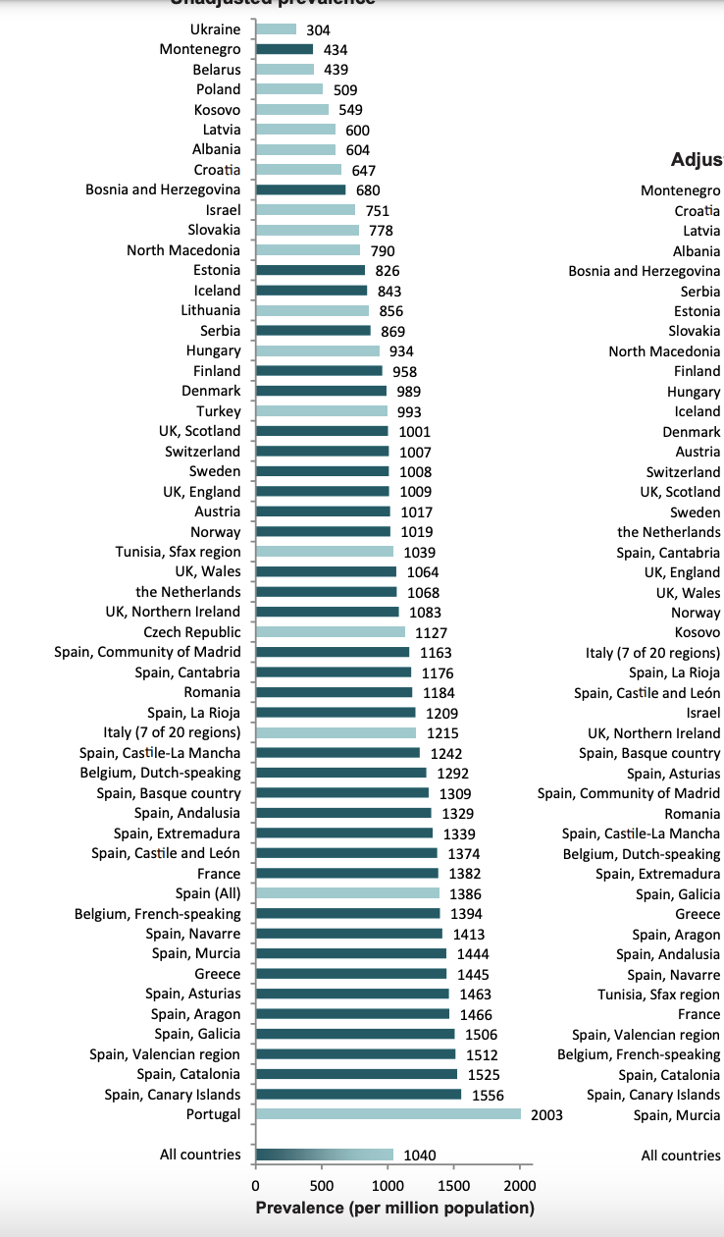

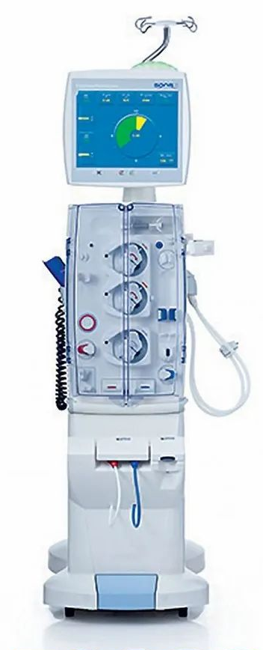
Introduction
Portugal has a high prevalence of patients under maintenance kidney replacement therapy (KRT).
In 2022 there were 12878 patients on maintenance hemodialysis in Portugal.
BOERSTRA, Brittany A., et al. Clinical Kidney Journal, 2023, sfad281.

Slide 3
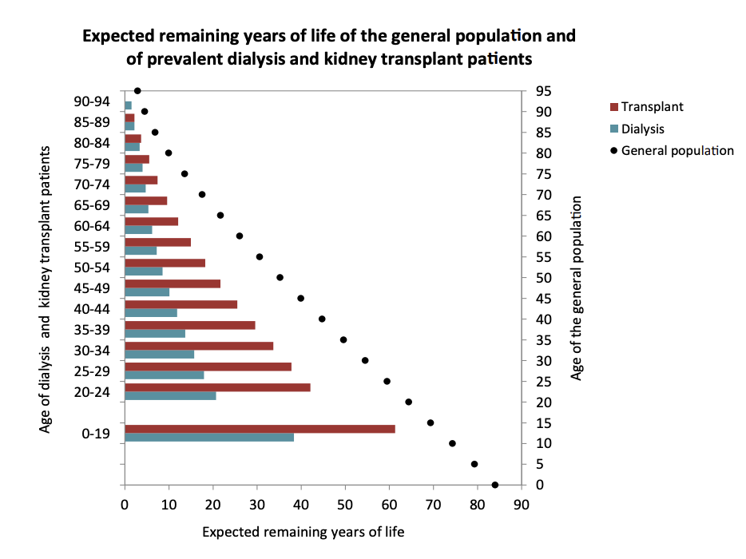
Introduction
Patients under KRT have a high mortality rate.
Mortality predictors?
Small solute clearence and Kt/V
Residual renal function
Vascular access
Albumin and BMI
Hemoglobin levels
Fluid overload
...
GARCIA-MONTEMAYOR, Victoria, et al. Clinical Kidney Journal, 2021, 14.5: 1388-1395.
ZOCCALI, Carmine, et al. Journal of the American Society of Nephrology: JASN, 2017, 28.8: 2491.
BOERSTRA, Brittany A., et al. Clinical Kidney Journal, 2023, sfad281.

Slide 4
Introduction: fluid overload
Fluid overload has been independently related to cardiovascular and all cause mortality in hemodialysis patients.
Flythe et al. (2015)
30-day follow-up
≥30% treatments with > 2 Kg difference over dry-weight (↥ or ⤓)
Mortality risk increased 28%
Zocalli et al. (2017)
1-year follow-up
Fluid overload (FO) using Bioimpedance
Mortality risk of chronic FO increased 50%
FLYTHE, Jennifer E., et al. Clinical Journal of The American Society of Nephrology: CJASN, 2015, 10.5: 808.
ZOCCALI, Carmine, et al. Journal of the American Society of Nephrology: JASN, 2017, 28.8: 2491.
How can we establish an euvolemic state?
Clinical assessment of dry-weight
Bioimpedance analysis
Blood Volume Monitoring
Lung ultrasound

Slide 5
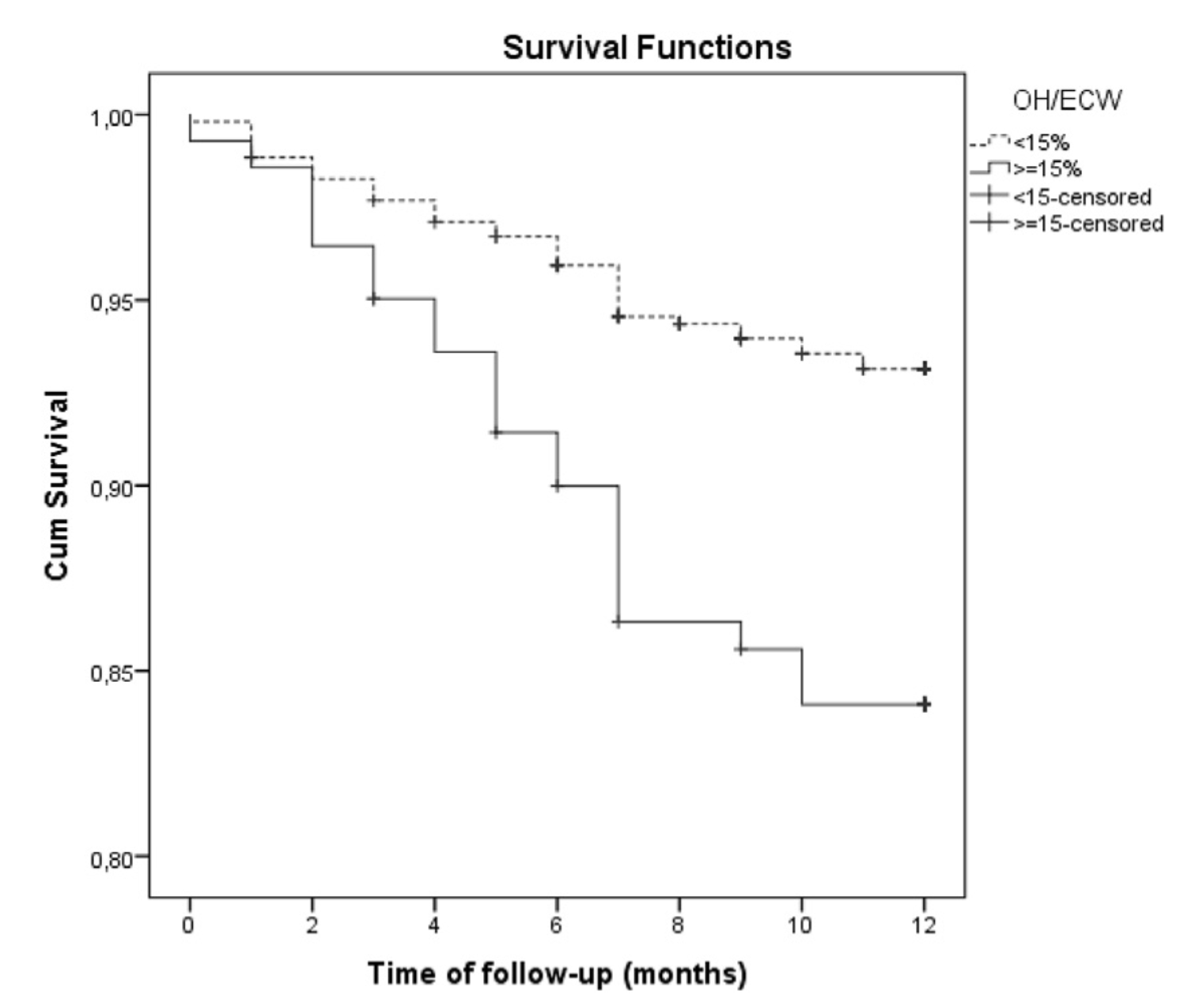
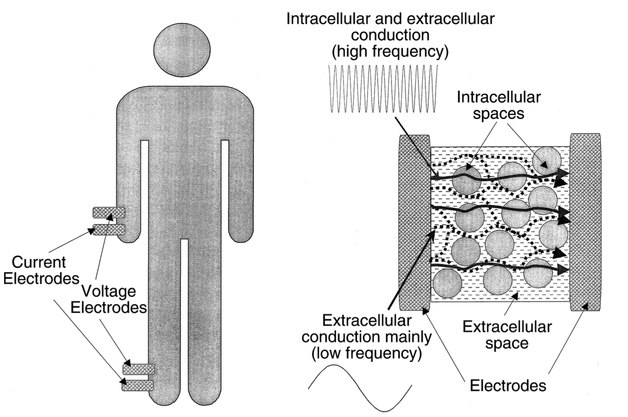
Introduction: fluid overload
Bioimpedance analysis
KDOQI guidelines
CHAMNEY, Paul W., et al. Kidney international, 2002, 61.6: 2250-2258.
CAETANO, Cristina, et al. Journal of Renal Nutrition, 2016, 26.2: 81-86.
Validated, non-invasive bedside technique.
Estimates:
total body water (TBW)
extracellular water (ECW)
intracellular water (ICW)
overhydration (OH)
inability to detect the location of extracellular volume expansion
misinterpretation of the results can occur if the patient’s body position is not correct, or electrodes cannot be appropriately placed

Slide 6
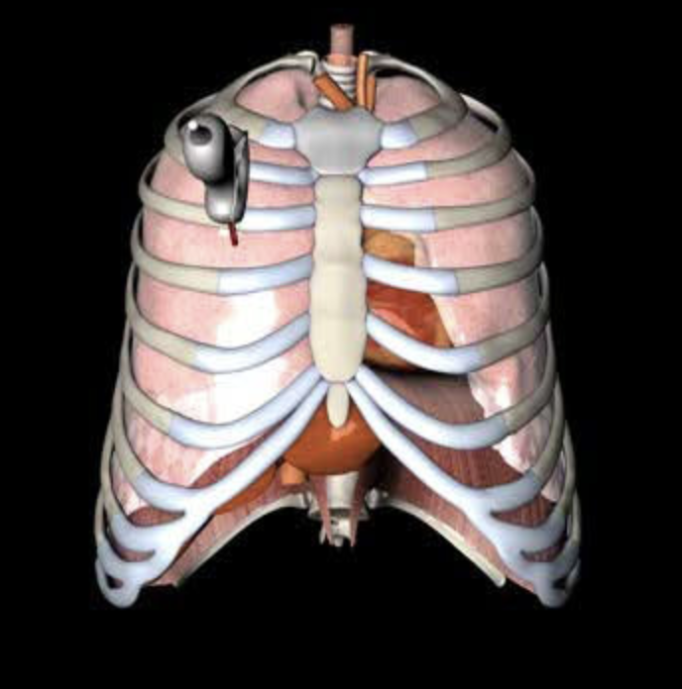
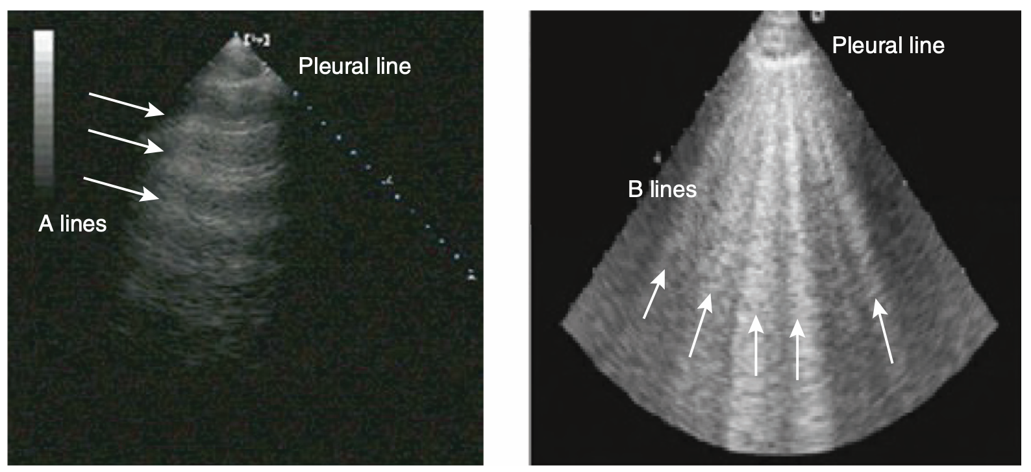
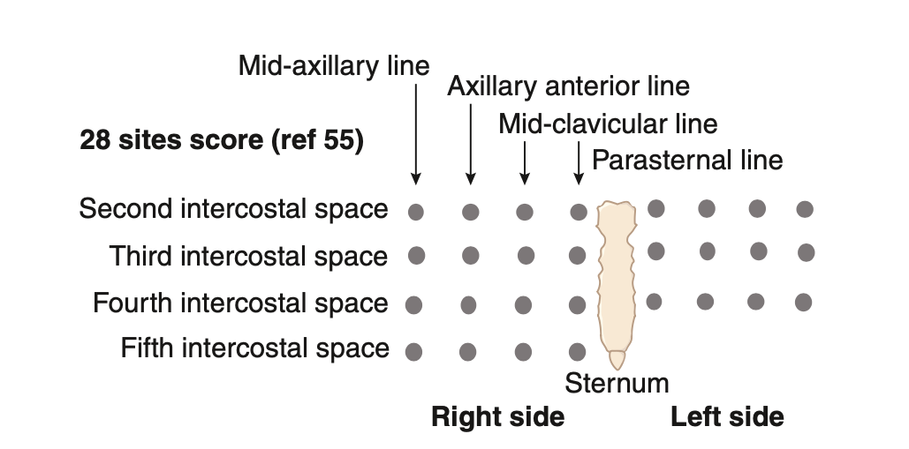
Introduction: fluid overload
Lung ultrasound
Other studies with other patologic conditions
ICU trials showed that abreviated protocols (8-zone) had similar ROC-AUC curves for prognostication of clinical deterioration in nonventilated COVID-19 patients.
Standard protocol used in most clinical trials
LEVY ADATTO, Nimrod, et al. Journal of Ultrasound in Medicine, 2022, 41.7: 1677-1687.
4-zone method has been described in patients with heart failure, in which the presence of 7 or more B-lines at hospital discharge conferred poor prognosis.
28 zones
PLATZ, Elke, et al. JACC: Heart Failure, 2019, 7.10: 849-858.
ZOCCALI, Carmine; MALLAMACI, Francesca; PICANO, Eugenio. Clinical Journal of the American Society of Nephrology, 2022, 17.5: 757-765.

Slide 7
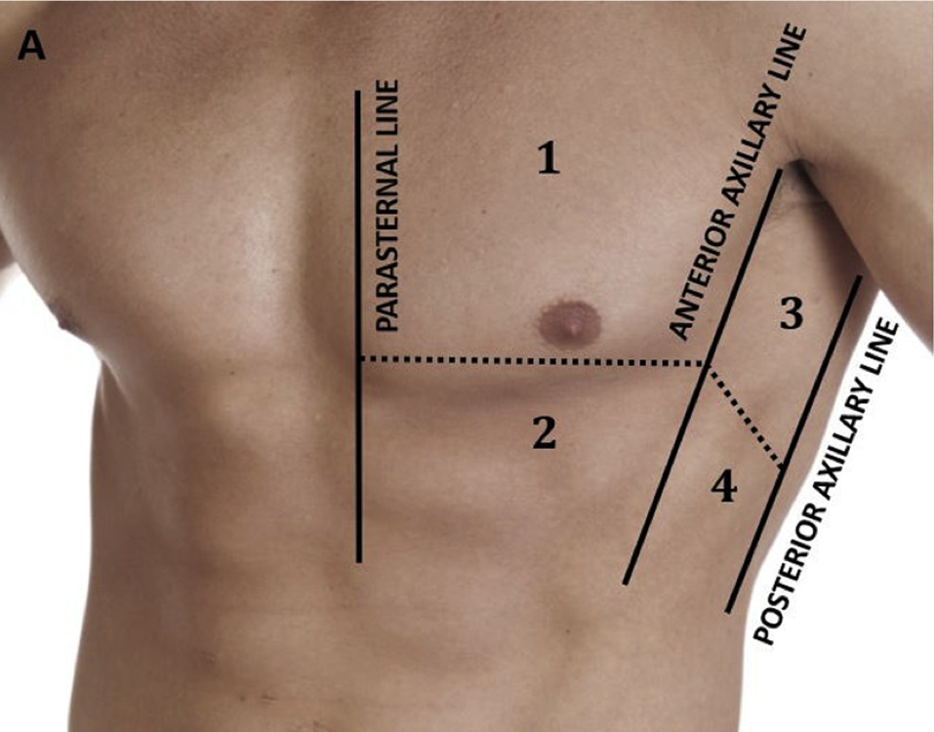
Aim of our study
8-zone protocol
Compare the performance of an 8-zone lung ultrasound protocol with bioelectrical impedance analysis to evaluate hydration status in our outpatient hemodialysis unit.

Slide 8
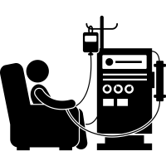
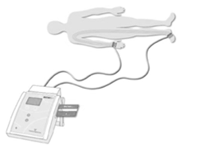
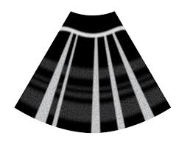
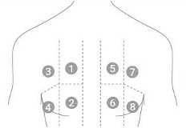
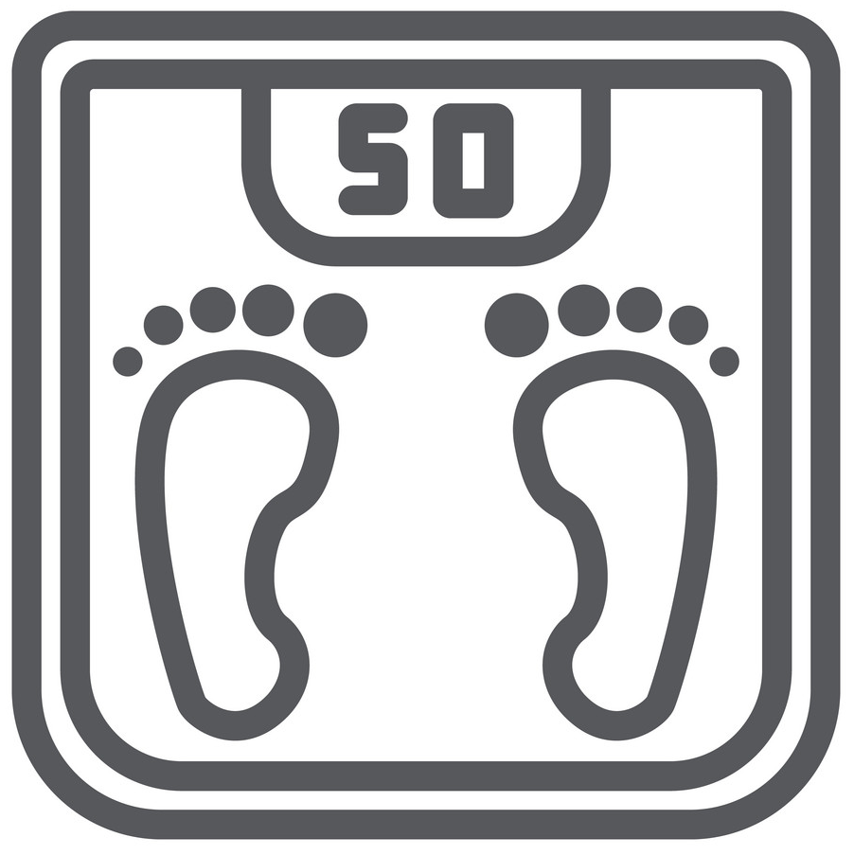
Methods
Prospective observational study
BEFORE HD session
Hemodialysis adult patients were enrolled
8-ZONE METHOD
Early-week dialysis
June – August 22
Bioimpedance (normalized OH)
Ultrasound
(total B lines)
Exclusion criteria:
< 1 month vintage;
limb amputation;
metallic medical devices;
systemic infections;
advanced neoplasia;
decompensated cirrhosis.
AFTER HD session
8-ZONE METHOD
Ultrasound
(total B lines)
Dry weight - established by the attending nephrologist (blind to the results)

Slide 9
Results
Baseline characteristics
HD parameters of early week session
37 patients
median age 60 years (IQR 50-75)
75% male
65% with residual diuresis >300 mL/24 h
median HD vintage 9 months (IQR 5-15)
median BMI 22.7 Kg/m² (IQR 19.7 – 26.8)
Parameter | Value (IQR)
Median systolic BP before HD (mmHg) | 140 (132-156)
Median diastolic BP before HD (mmHg) | 79 (73-89)
Median interdialytic weight gain (%) | 4,2% (2.8-5.6)
Median UF (ml) | 2600 (1700-3000)

Slide 10
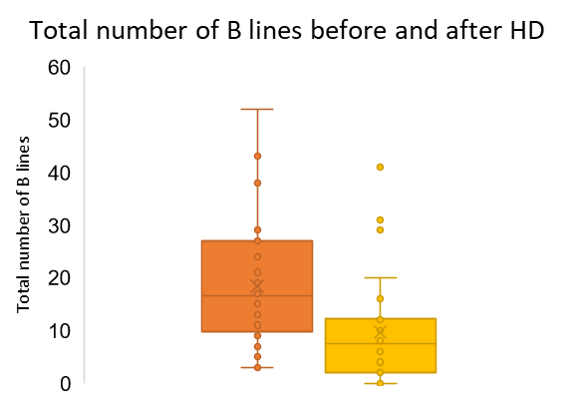

Results
Bioimpedance analysis (before HD)
Lung US before and after HD
Parameter | Value (IQR)
Total body water TBW (L) | 38.2 (34-45)
Extracellular water ECW (L) | 18.2 (14.6-22.4)
Intracellular water ICW (L) | 20.8 (17.7-24.2)
Normalized overhydration (%) | 13.8 (3-18)
*
Normalized overhydration (%) = $\left(\frac{OH}{ECW}×100\right)$
Before HD
After HD
The number of B-lines at the beginning and at the end of the HD were statistically different (* p<0,001).

Slide 11
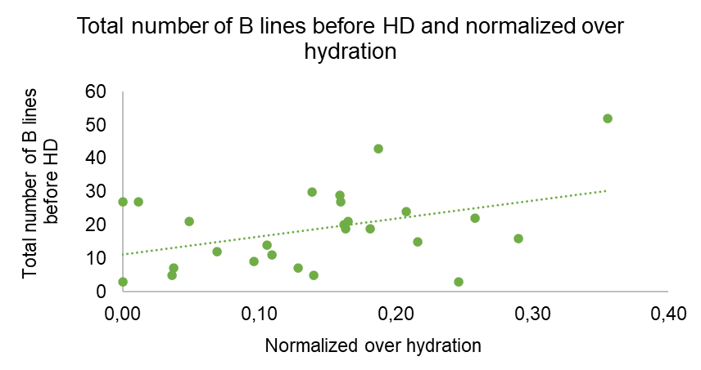
Results
Relation between Lung US and Bioimpedance
The number of B lines also correlated with ECW (r=0.501, p=0.007), TBW (r=0.418, p=0.030), but not ICW (r=0.239, p=0.23)
r=0.454, p=0.018

Slide 12
Conclusion
The 8-zone Lung US protocol is efficient to evaluate patients prior to HD sessions.
There is a good correlation between the total number of B lines determined by the 8-zone protocol and bioimpedance parameters such as TBW, ECW, and normalized OH.
This demonstrates that the 8-zone protocol can effectively be used in routine evaluations of HD patients. Although these techniques reflect different over-fluid compartments, they have a complementary role for fluid overload determination and dry weight guidance.

Slide 14
8-ZONE LUNG ULTRASOUND AND BIOIMPEDANCE ANALYSIS FOR ASSESSMENT OF HYDRATION STATUS IN HEMODIALYSIS
Andreia Curto, Pedro Campos, Mariana Ramos, Inês Alexandre, Ana Catarina Brás, Afonso Santos, Miguel Verdelho, Ana Pires, Adelaide Serra, Fernando Domingos
DEPARTMENT OF NEPHROLOGY
30th January 2024

