Slide 1

Cardioneuroablation: a new era for vagal syncope?
Prémio Científico
Caso Clínico
Joana Lima Lopes | Nuno Cabanelas| Marco Beringuilho | AR Ferreira | Mariana Faustino | Francisco Madeira
Serviço de Cardiologia

Slide 2



Case report PRESENTATION
  42 years old male athlete
  Bradycardia and vagal syncope episodes
  ECGs showed sinus rhythm with bradycardia (40-44 bpm)
  Transthoracic Echocardiogram: normal
  TILT test: positive - 2b cardio inhibitory response and 20s asystole

Slide 3

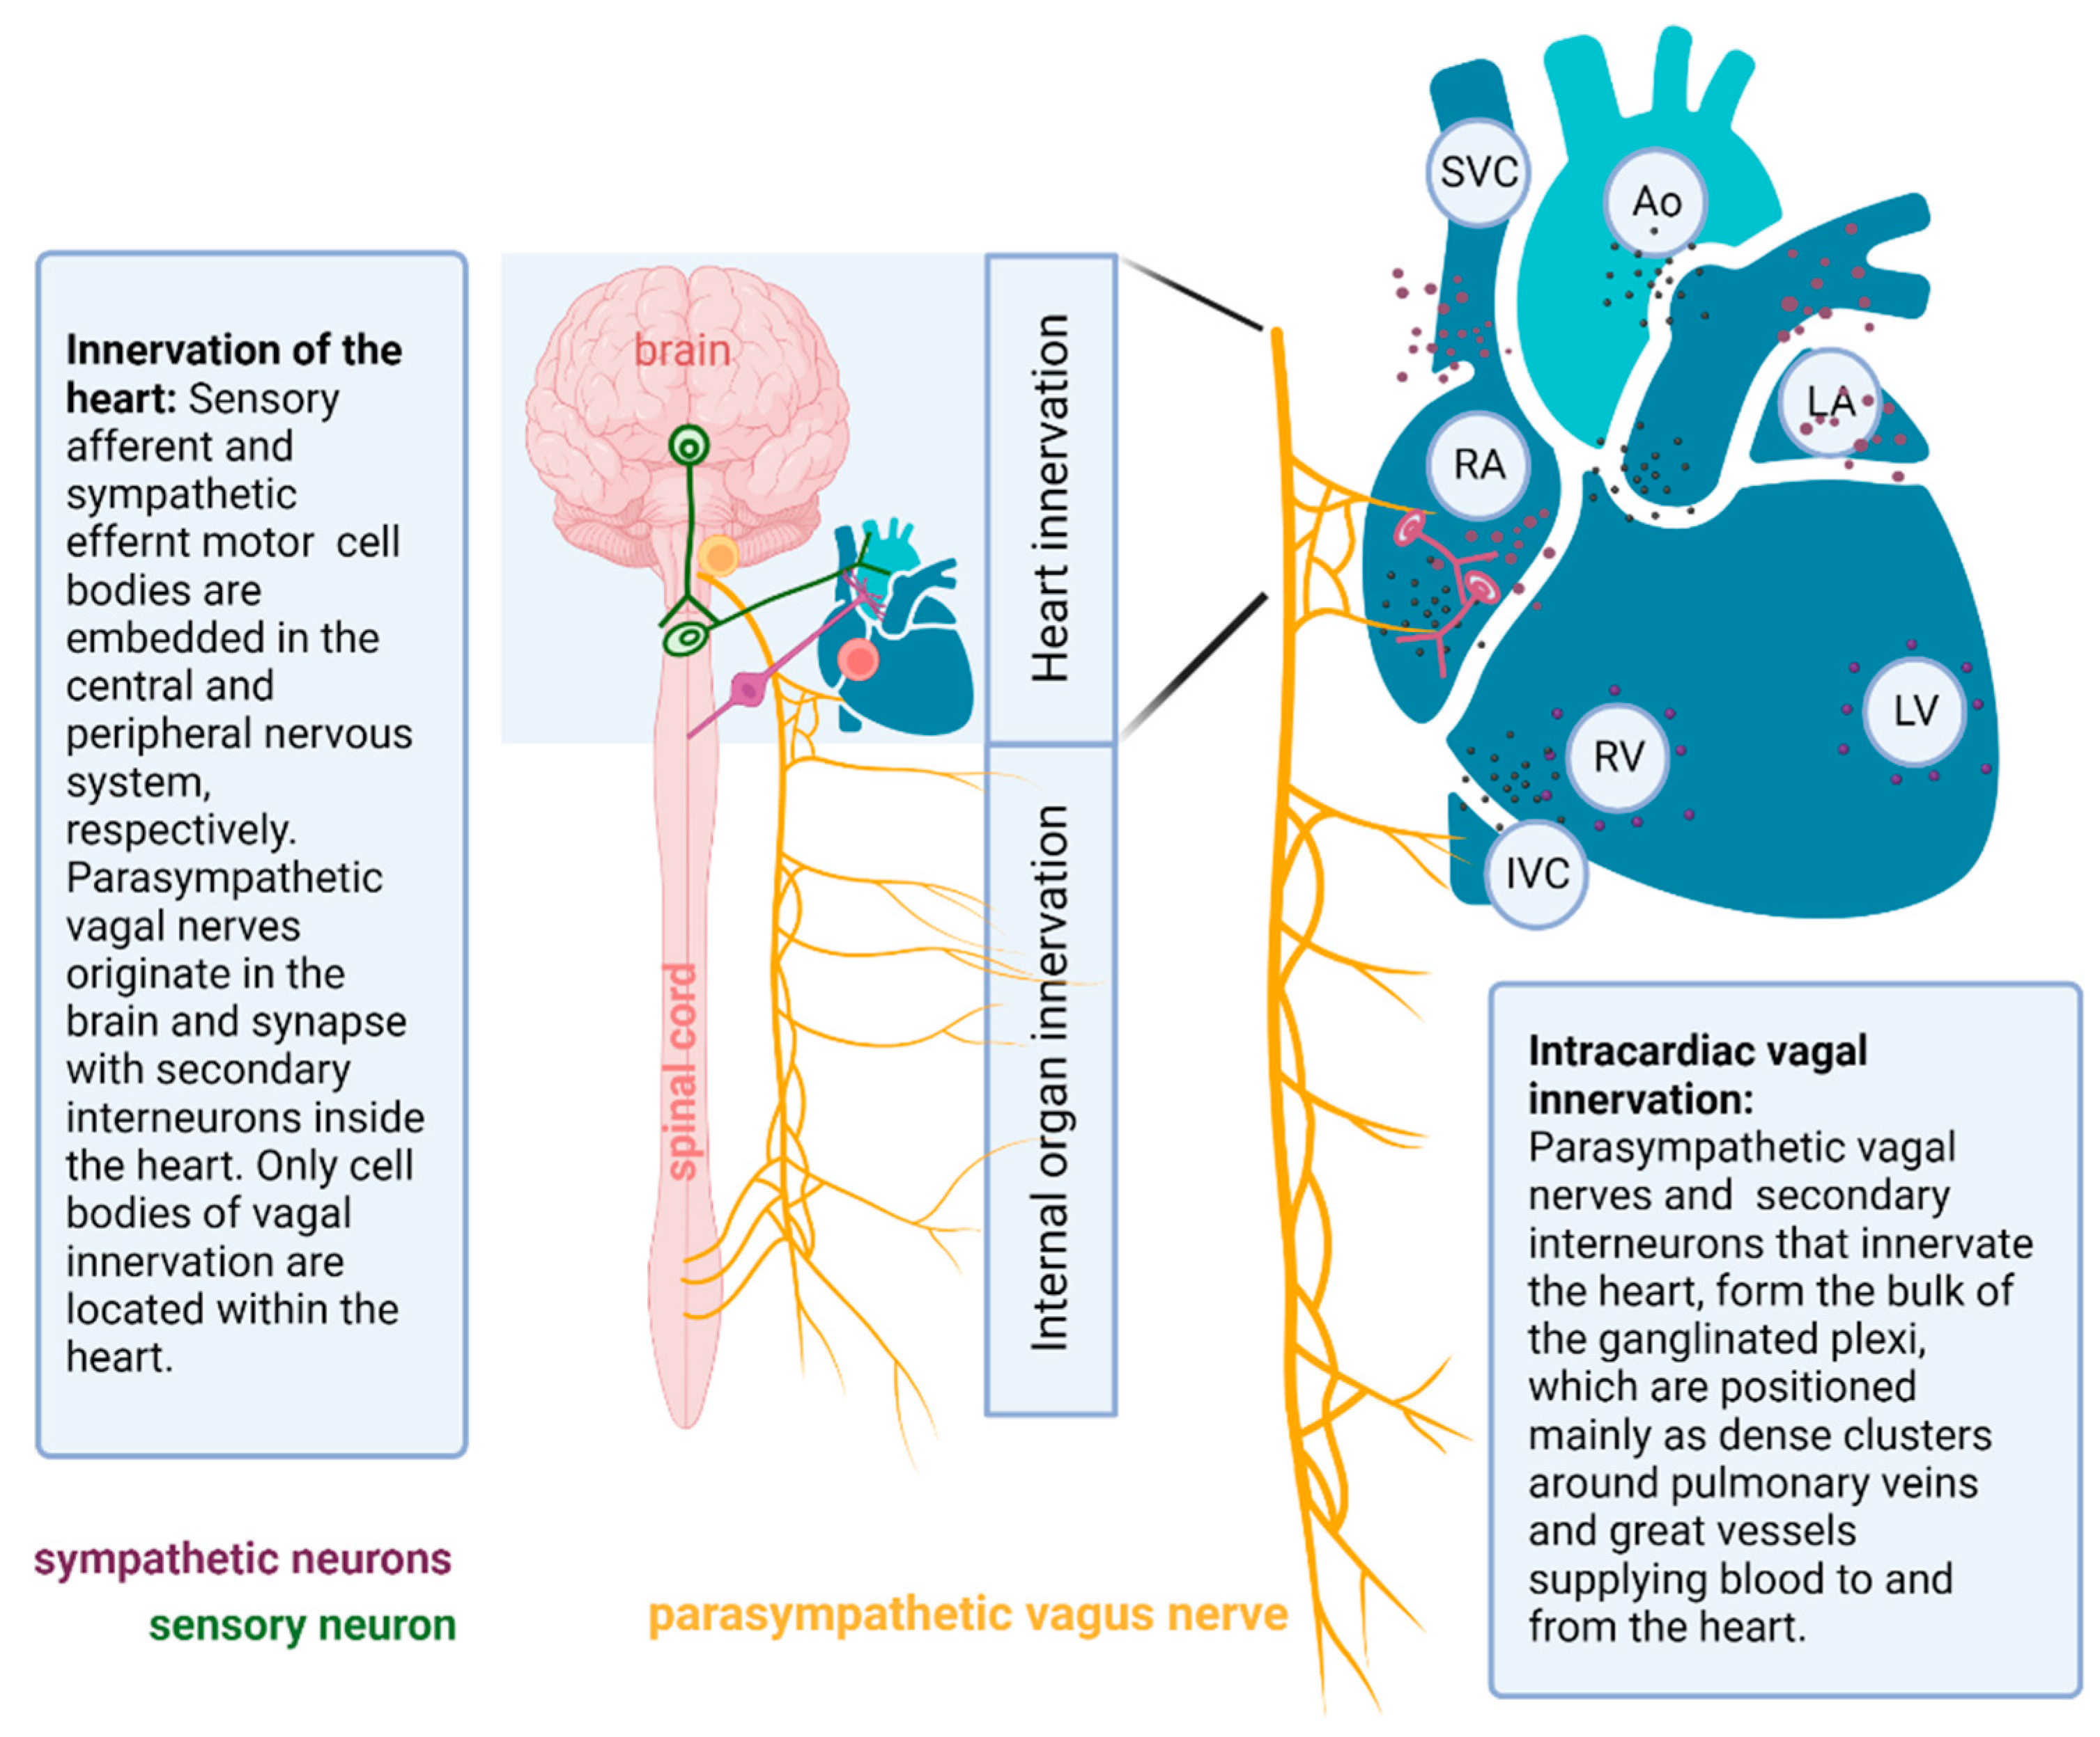
Cardioneuroablation: an innovative tecnhique
Notes:
The autonomic nervous system affects the physiological function of cardiovascular system¹. Tonic activation of the vagus may result in hypotension, bradycardia, and potentially vasovagal syncope (VVS). Ganglionated plexi (GPs) are intrinsic structures located in the epicardial atrial fat pads which connect preganglionic and postganglionic nerve fibers that affect HR, atrial and ventricular refractoriness and cardiac function¹. The GPs are the selected target for cardioneuroablation: by destroying some of these GP, we then reduce the vagal input over the heart and so prevent excessive reduction of HR, excessive hypotension and thus VVS. There are hundreds of GPs that bring vagal input to the heart, but it is known the location of the ones that most influence HR (fibers that reach atria sinus and atrioventricular node) and thus we can target those during the cadioneuroablation procedure.

Slide 4
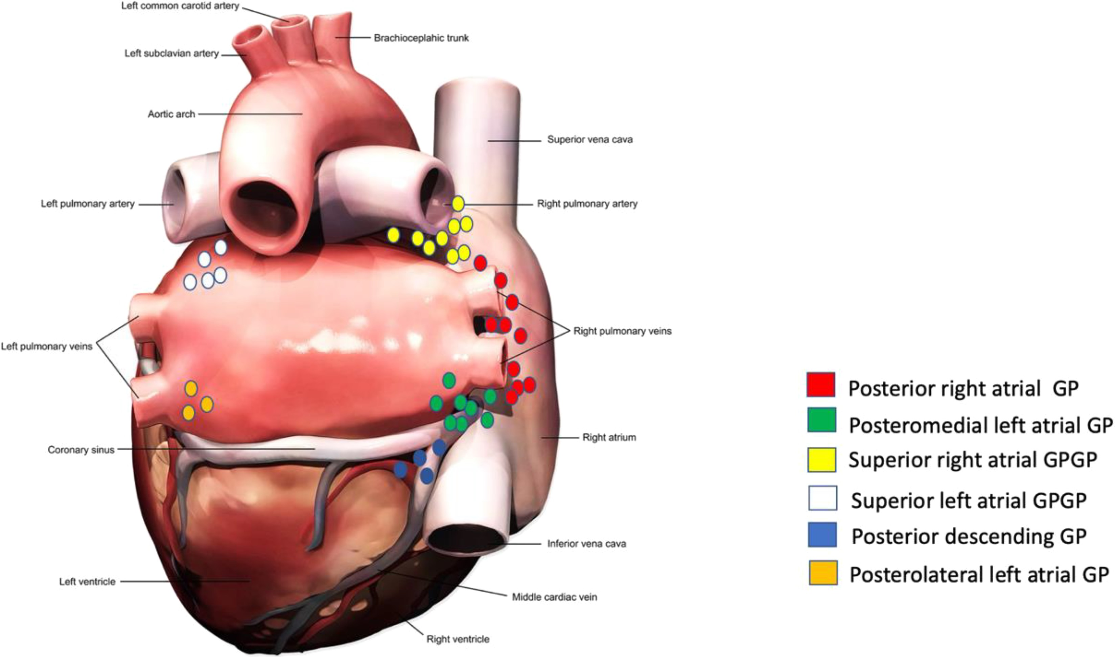
Cardioneuroablation: an innovative tecnhique

Slide 5
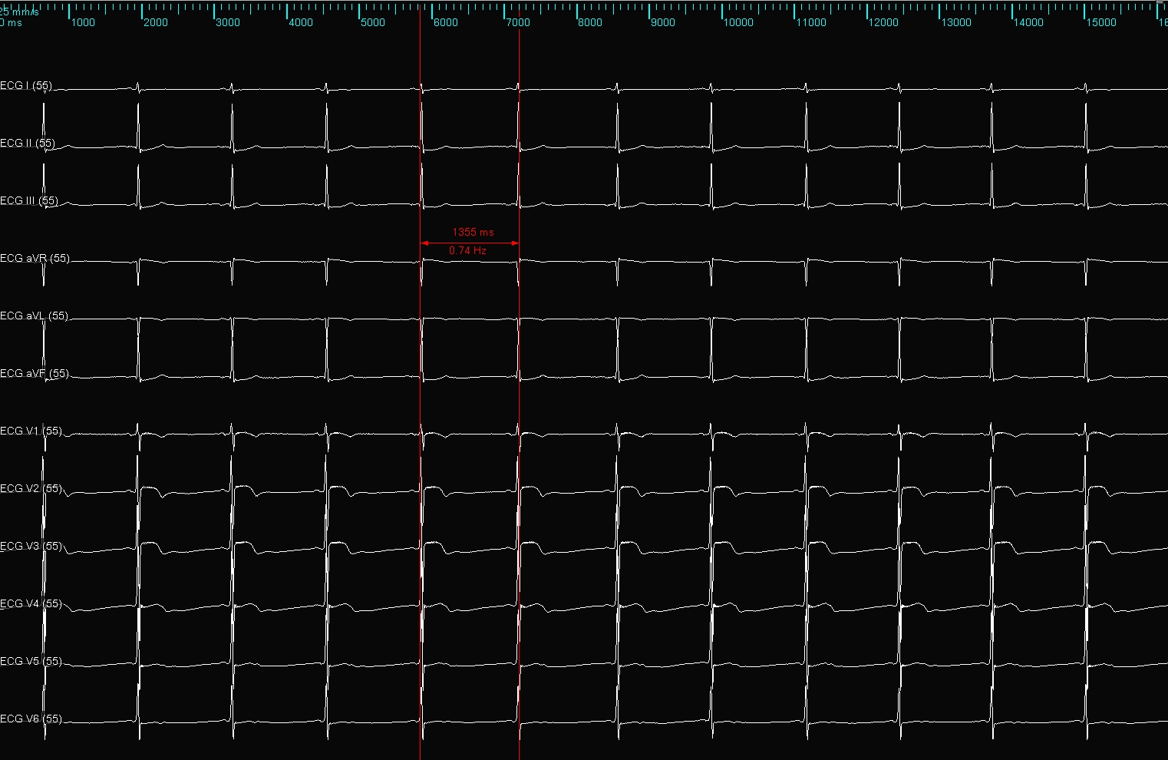
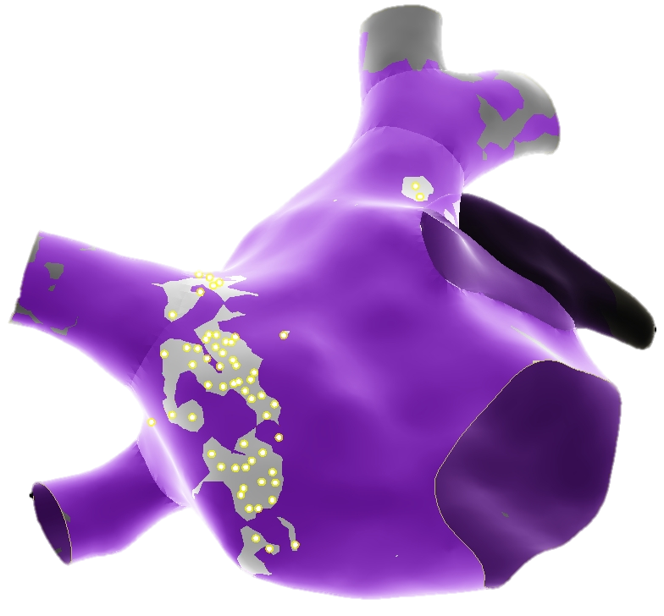
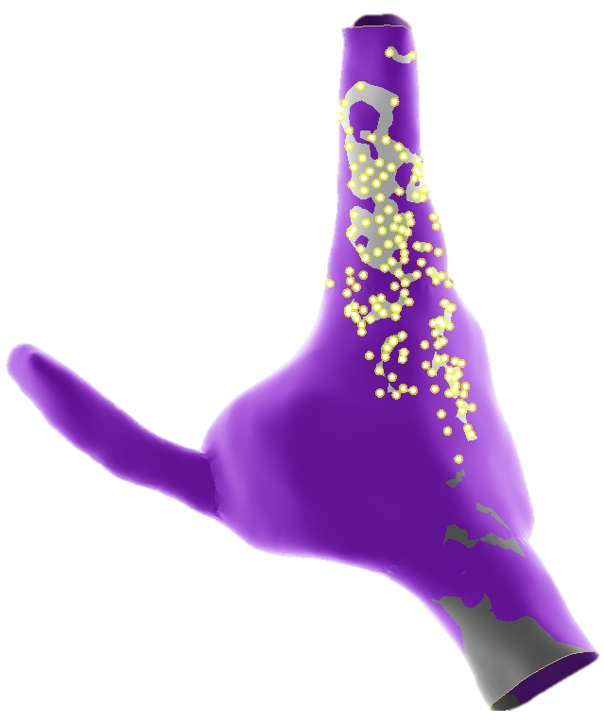
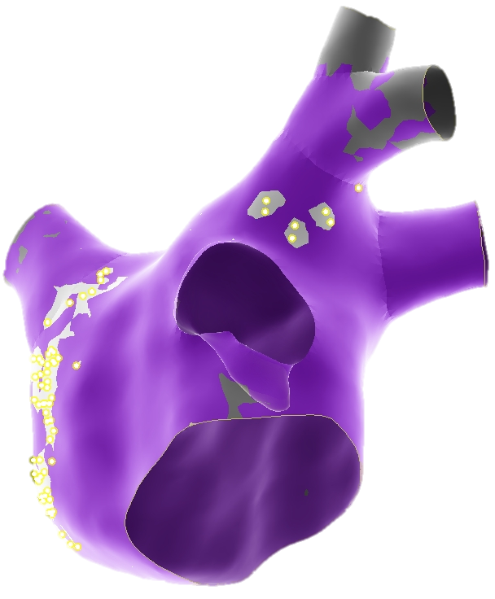
Case report: The procedure
BEGINING OF THE PROCEDURE
2
1
MAPPING
Fig1 Sinus rhythm, 1:1 AV conduction, 44bpm
Fig.2 Fractionation map (LA and RA): left superior GP, right superior and inferior GP, superior vena cava, crista terminalis
LA: left atrium; RA: right atrium; GP: ganglion plexi, AV: atrio-ventricular;

Slide 6
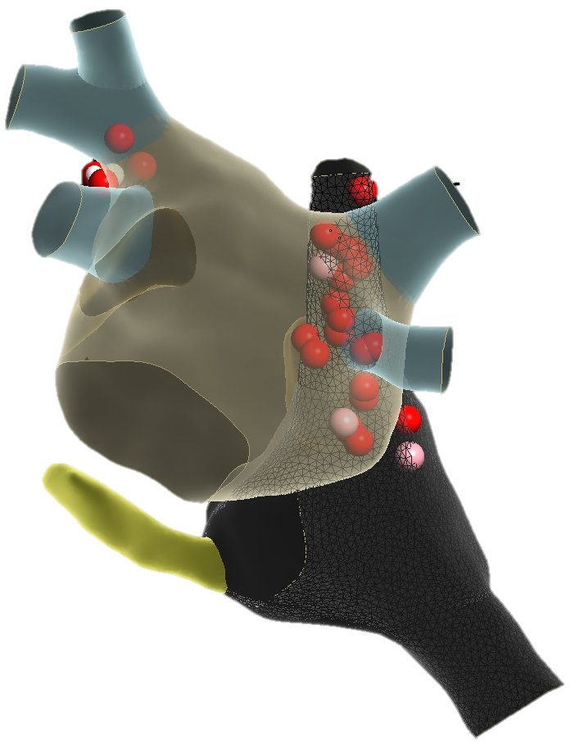
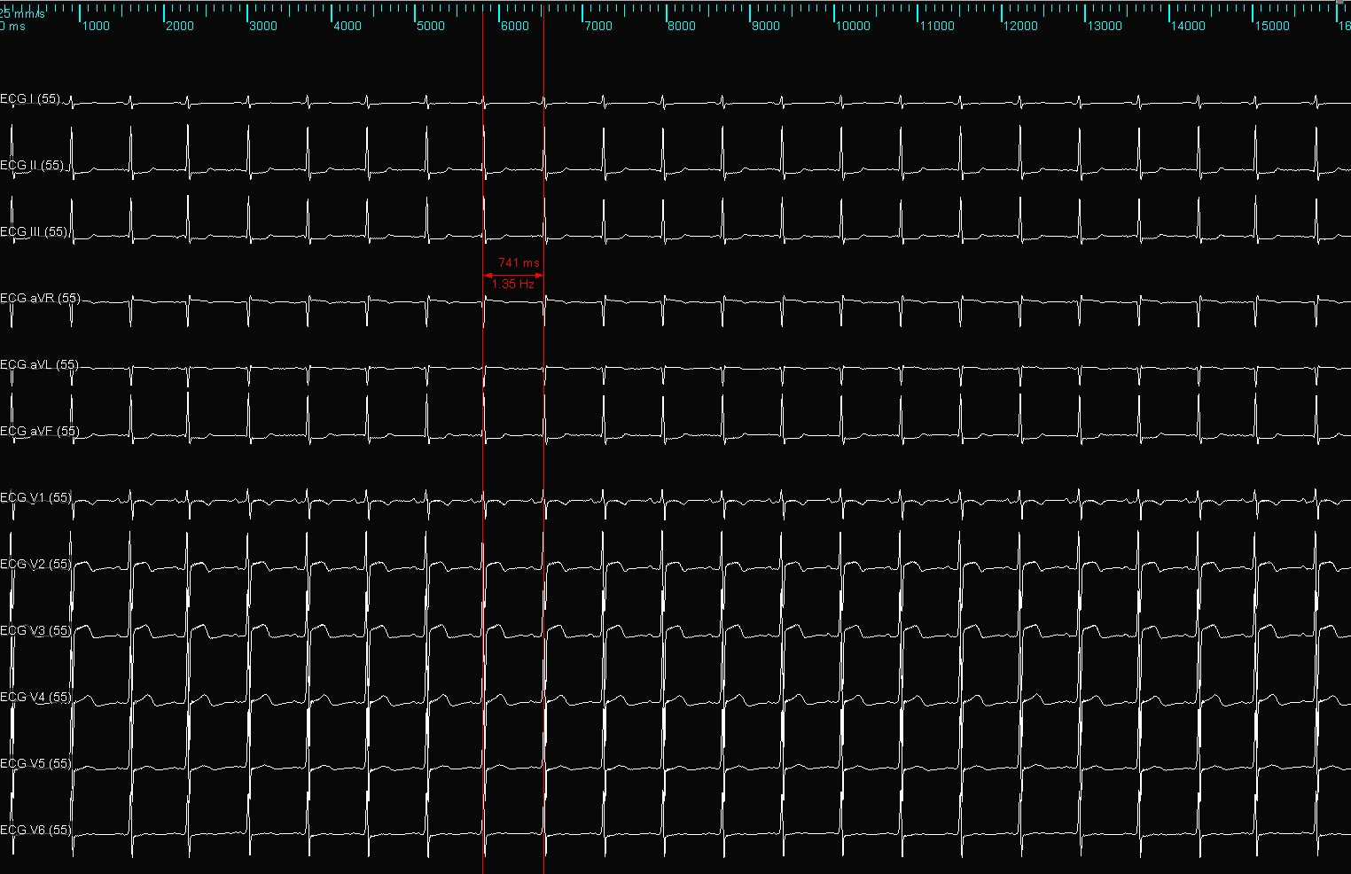
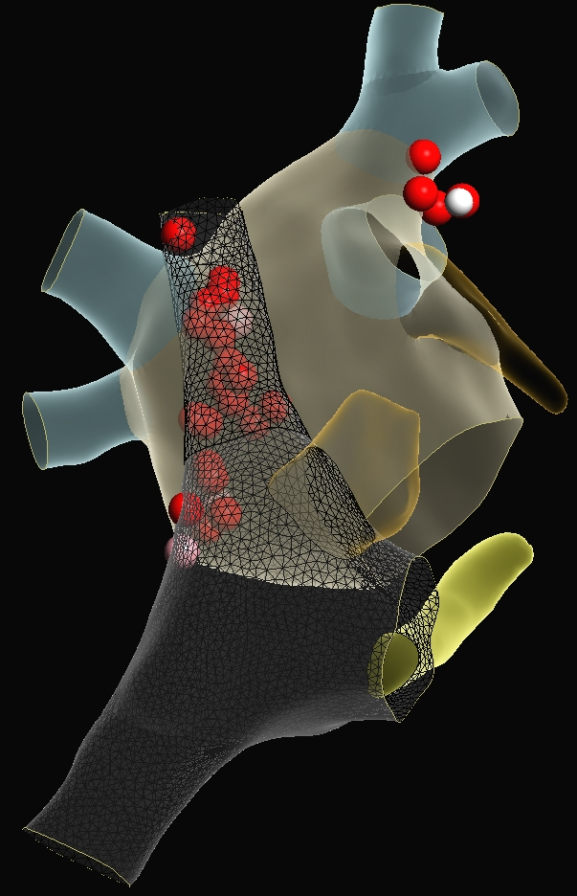
Case report: The procedure
RADIOFREQUENCY APLICATION
4
3
RESULT
Fig.3 RF lesions superior vena cava and left superior GP
Fig.4 Final ECG Sinus rhythm, 1:1 conduction, 81bpm
  After atropine test, no significant change occurred in cycle length)
RF: radiofrequency; GP: ganglion plexi

Slide 7
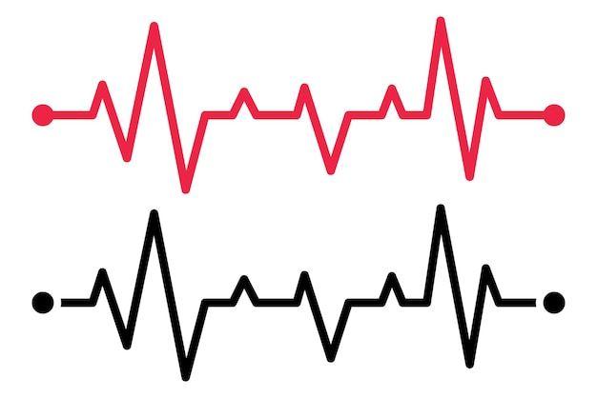
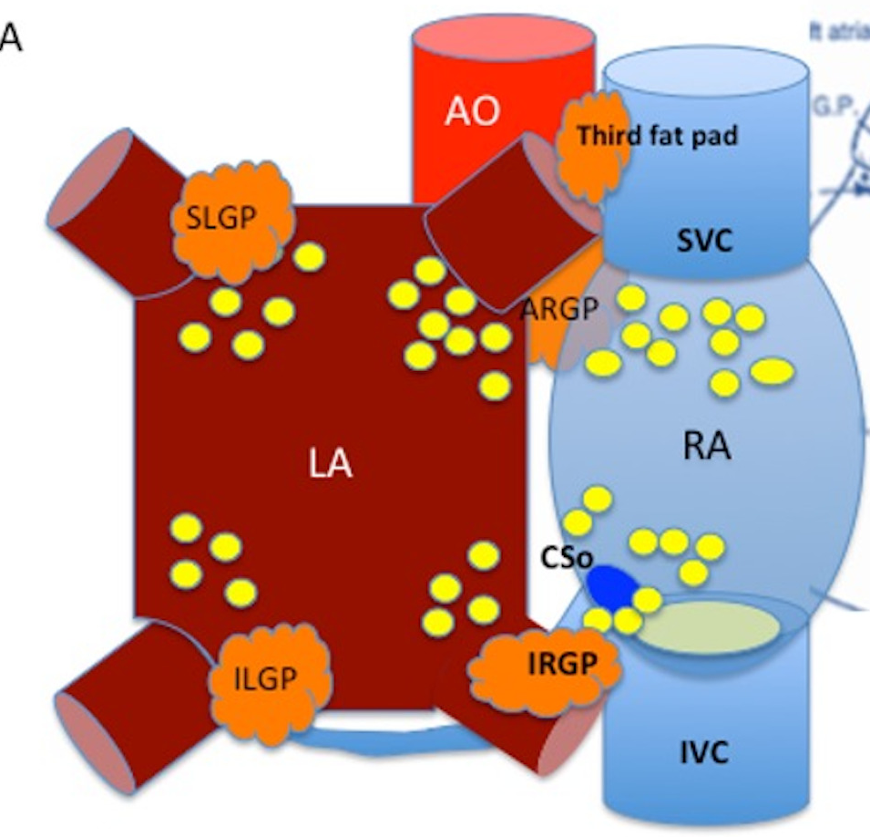
Conclusions
After RF application the patient’s HR rose from 44 to 80bpm (the patient had never had before HR>50bpm)
Cardioneuroablation is an innovative techique capable of reducing vagal bradicardya and syncope episodes, significantly improving quality of life and avoiding pacemaker implantation.
RF: radiofrequency; HR: heart rate

Slide 8

OBRIGADO
Joana Lima Lopes
30/01/2024

