Slide 1

SAFETY AND EFFICACY OF DOLUTEGRAVIR BASED TRIPLE THERAPY IN HIV-2 INFECTION
RESULTS FROM A 48-WEEK PHASE 2 STUDY
Patrícia Pacheco, Nuno Marques, Paulo Rodrigues, Kamal Mansinho, Fernando Maltez, Nuno Janeiro, Cláudia Franco, Diva Trigo, Joana Batista, Luís Duque,
Maria João Lopes, Maria João Aleixo, Ana Rita Silva, Raquel Tavares, João Alves, Susana Peres, Diana Póvoas, Sara Lino, Perpétua Gomes, Vânia Araújo, Cristina Lopes
PRÉMIO CIENTÍFICO
HOSPITAL PROFESSOR DOUTOR FERNANDO FONSECA
Edição 2023
Maria João Lopes
Assistente Hospitalar de Doenças Infecciosas - Serviço de Infecciologia
30 Janeiro 2024

Slide 2
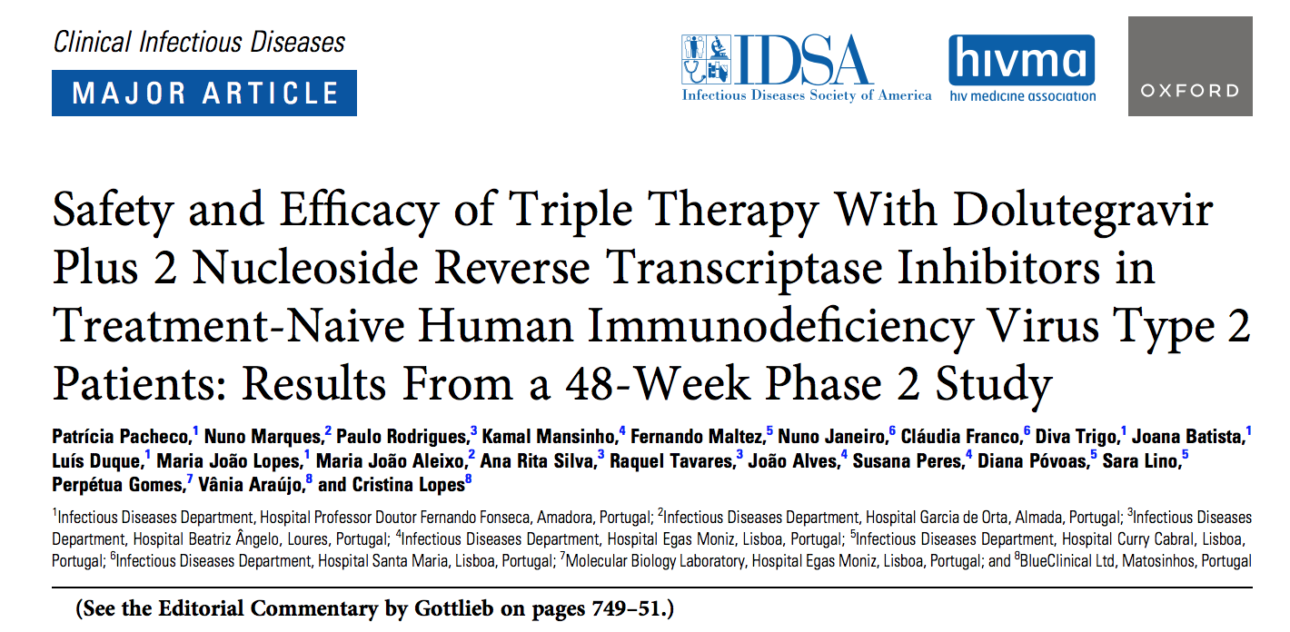

SAFETY AND EFFICACY OF DOLUTEGRAVIR BASED TRIPLE THERAPY IN HIV-2 INFECTION
Clinical Infectious Diseases® 2023;77(5):740–8
Received 11 January 2023; editorial decision 14 April 2023; published online 8 June 2023 ; published September 1

Slide 3
SAFETY AND EFFICACY OF DOLUTEGRAVIR BASED TRIPLE THERAPY IN HIV-2 INFECTION
Disclaimer
This was an investigator-initiated trial supported by ViiV Healthcare.
The funders had no role in the study design, data collection, data analysis, data interpretation, or writing the report.
All operational aspects of the study, including monitoring, data collection, and statistical analyses, were managed by the authors and BlueClinical, Ltd.
All authors had full access to all study data and are responsible for the veracity and completeness of the data reported.
Principal investigator: Patrícia Pacheco

Slide 4
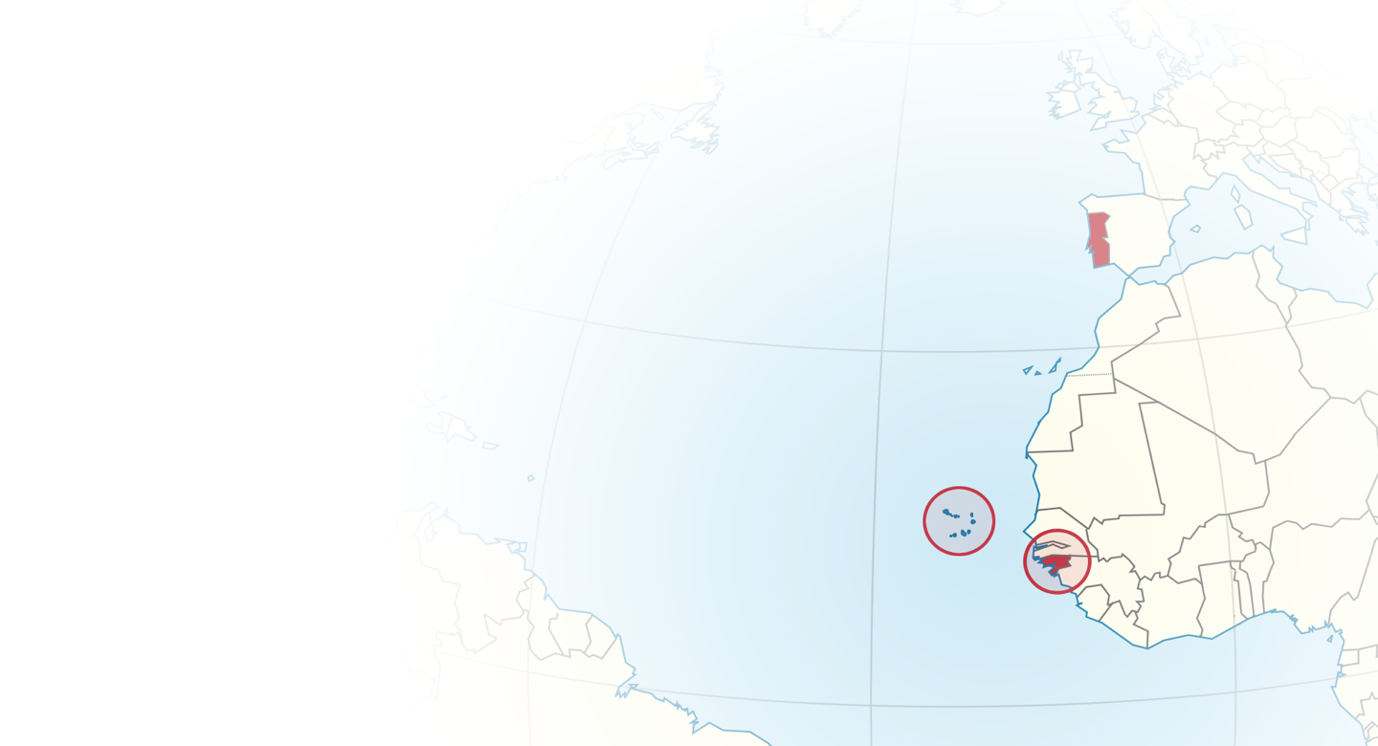
SAFETY AND EFFICACY OF DOLUTEGRAVIR BASED TRIPLE THERAPY IN HIV-2 INFECTION
BACKGROUND
Two HIV strains were identified in humans, HIV-1 and HIV-2, and both may cause AIDS.
HIV-2 was identified in 1986 in Portugal.¹ HIV-2 is endemic in West Africa and more prevalent in European countries with socioeconomic ties to this region.²
Portugal is the European country with the highest prevalence of people with HIV-2 (PWHIV2) - 3.2% of HIV cases.³
¹ Clavel et al N Engl J Med 1987; 316:1180-1185 ² Gottlieb et al Lancet HIV 2018; 5: e390–99 ³ Relatório Infeção por VIH em Portugal 2023, INSA
Notes:
HIV-1 and HIV-2 share similarities but have also major differences. In fact, HIV-1 is the most prevalent and occurs worldwide, whereas HIV-2 is mainly confined to West Africa and European countries with socioeconomic ties to this region. Portugal is the European country with the highest prevalence of people with HIV-2 (PWHIV2).

Slide 5





SAFETY AND EFFICACY OF DOLUTEGRAVIR BASED TRIPLE THERAPY IN HIV-2 INFECTION
BACKGROUND
LOW PREVALENCE 1 to 2 million PWHIV2 worldwide
DIFFICULT TO TREAT intrinsic resistance, resistance selection
PATIENT MONITORING CD4 count, pVL mostly undetectable
HIV-2 CHALLENGES
LIMITED EVIDENCE clinical guidelines
Camacho RJ Intervirology 2012; 55:179–83, Gottlieb et al Lancet HIV 2018; 5: e390–99
Notes:
HIV 38 million people worldwide (accounting for 3–5% of the global burden of HIV)
rapid emergence of drug resistance and cross-resistance within each drug class dramatically reduces second-line treatment options.
treatment is mainly based in in vitro studies and clinical reports.

Slide 6

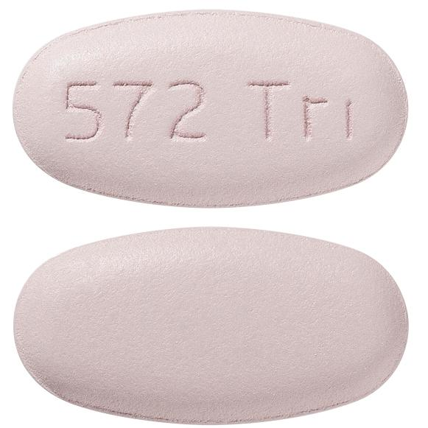
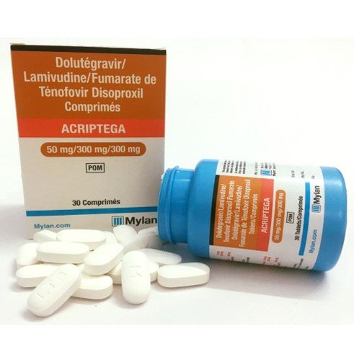
SAFETY AND EFFICACY OF DOLUTEGRAVIR BASED TRIPLE THERAPY IN HIV-2 INFECTION
BACKGROUND
Integrase inhibitors have activity against HIV-2.
Dolutegravir (DTG) is a second-generation integrase inhibitor approved for the treatment of HIV-1 since 2014. The WHO recommends the use of a single tablet regimen of DTG (TDF/3TC/DTG, named TLD), as the preferred first-line treatment for all populations since 2019.¹
In vitro studies showed that DTG has activity on HIV-2.² Clinical data is however still limited.
Two Phase II clinical trials (both with 30 patients) conducted in France and Senegal demonstrated safety and efficacy of integrase inhibitors as first-line treatment in patients infected with HIV-2:
  Raltegravir + TDF/FTC (France, Matheron et al Clin Infect Dis 2018; 67: 1161–7);
  Elvitegravir (TDF/FTC/ELV/c) (Senegal, Ba et al Clin Infect Dis 2018; 67:1588–94).
This is the first trial ever done, using dolutegravir-based regimen in HIV-2.
¹ Policy brief UPDATE OF RECOMMENDATIONS ON FIRST- AND SECOND-LINE ANTIRETROVIRAL REGIMENS, WHO 2019 ² Smith et al Retrovirology 2015; 12:10

Slide 7


SAFETY AND EFFICACY OF DOLUTEGRAVIR BASED TRIPLE THERAPY IN HIV-2 INFECTION
STUDY DESIGN
Phase II, single-arm, open-label clinical trial
48 WEEKS
30 patients enrolled
People with HIV-2
Treatment-naïve
INTERVENTION
Dolutegravir (DTG) 50 mg once daily
given in combination with 2 NRTIs
Abacavir/Lamivudine - (ABC/3TC) or
Tenofovir disoproxil/Emtricitabine (TDF/FTC)
Hospital Professor Doutor Fernando Fonseca
Hospital Garcia de Orta
Hospital Beatriz Ângelo
Hospital Egas Moniz
Hospital Curry Cabral
Hospital Santa Maria
Multicenter
trial
Notes:
This is the first trial ever done, using dolutegravir based regimen and intents to generate clinical evidence on the efficacy and safety profile of triple therapy of Dolutegravir plus 2 NRTIs, in treatment naïve HIV-2- infected subjects.
Due to the exploratory nature of this study and for pragmatic reasons, namely, the estimated number of patients newly diagnosed with HIV-2 in Portugal each year, the sample size was a convenience sample of 30 patients and was not statistically derived.

Slide 8
SAFETY AND EFFICACY OF DOLUTEGRAVIR BASED TRIPLE THERAPY IN HIV-2 INFECTION
OBJECTIVES
PRIMARY
To evaluate the efficacy of Dolutegravir (DTG) in combination with two nucleoside reverse transcriptase inhibitors (NRTIs) in the treatment of HIV-2 treatment-naïve patients, measured by:
the proportion of patients who achieved a plasma viral load (pVL) of <40 copies/mL and/or
by the change from baseline in CD4 cell count and in CD4/CD8 ratio at Week 48.
SECONDARY
To evaluate the immunological effect, as measured by the change from baseline in CD4 cell count and the CD4/CD8 ratio at W48.
To evaluate the safety profile of the study treatment, assessed by the review of the accumulated safety data, such as treatment discontinuation rate and number, nature, severity, and time of adverse events (AEs).

Slide 9
SAFETY AND EFFICACY OF DOLUTEGRAVIR BASED TRIPLE THERAPY IN HIV-2 INFECTION
INCLUSION CRITERIA
Male or female gender
Age ≥ 18 years
HIV-2 positive
CD4 count ≤500 cells/mm³ (in case of undetectable baseline HIV-2 viral load); and/or classified as B- or C-stage, by the HIV disease staging and classification system of CDC; and/or have detectable viral load irrespective of CD4 count; and/or have other medical conditions/co-morbidities in which treatment is considered, according to EACS and national guidelines
Naïve to antiretroviral therapy
Considered clinically stable with no signs or symptoms of active infection

Slide 10
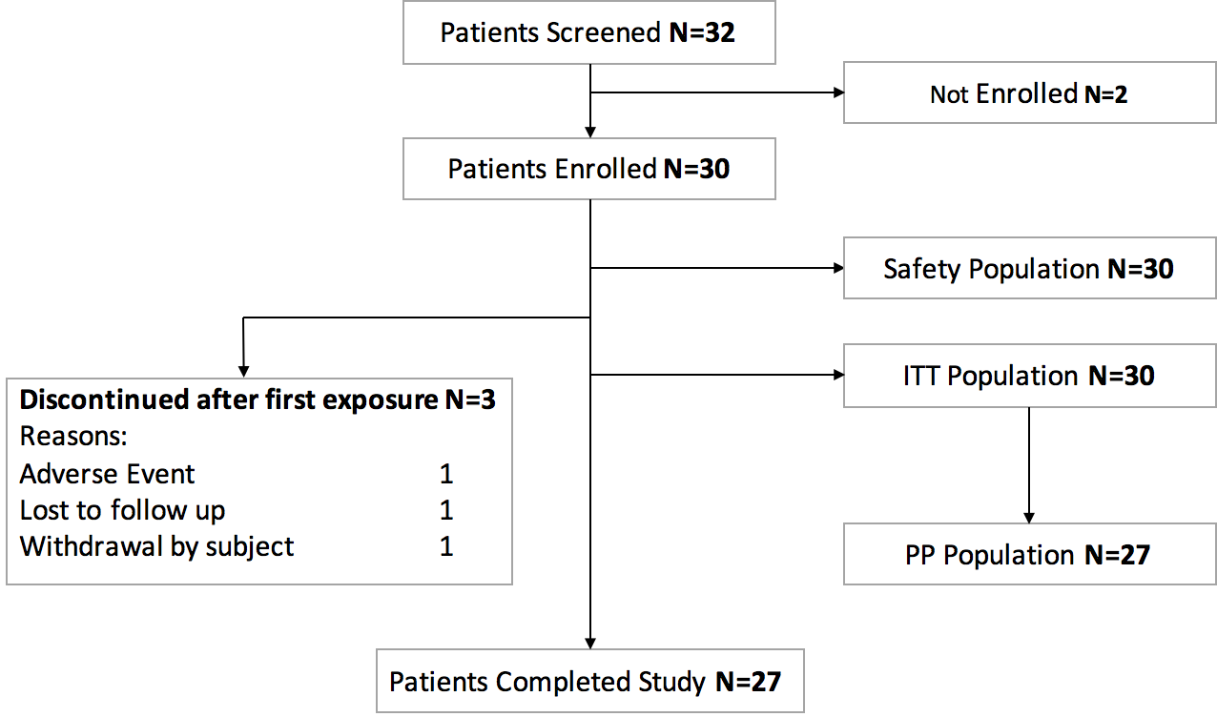
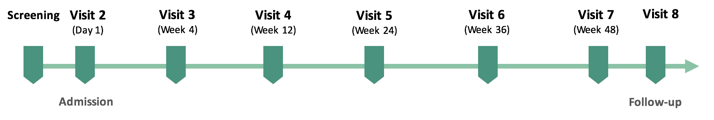
SAFETY AND EFFICACY OF DOLUTEGRAVIR BASED TRIPLE THERAPY IN HIV-2 INFECTION
PATIENT FLOW DIAGRAM
ITT, intention to treat
PP, per protocol

Slide 11
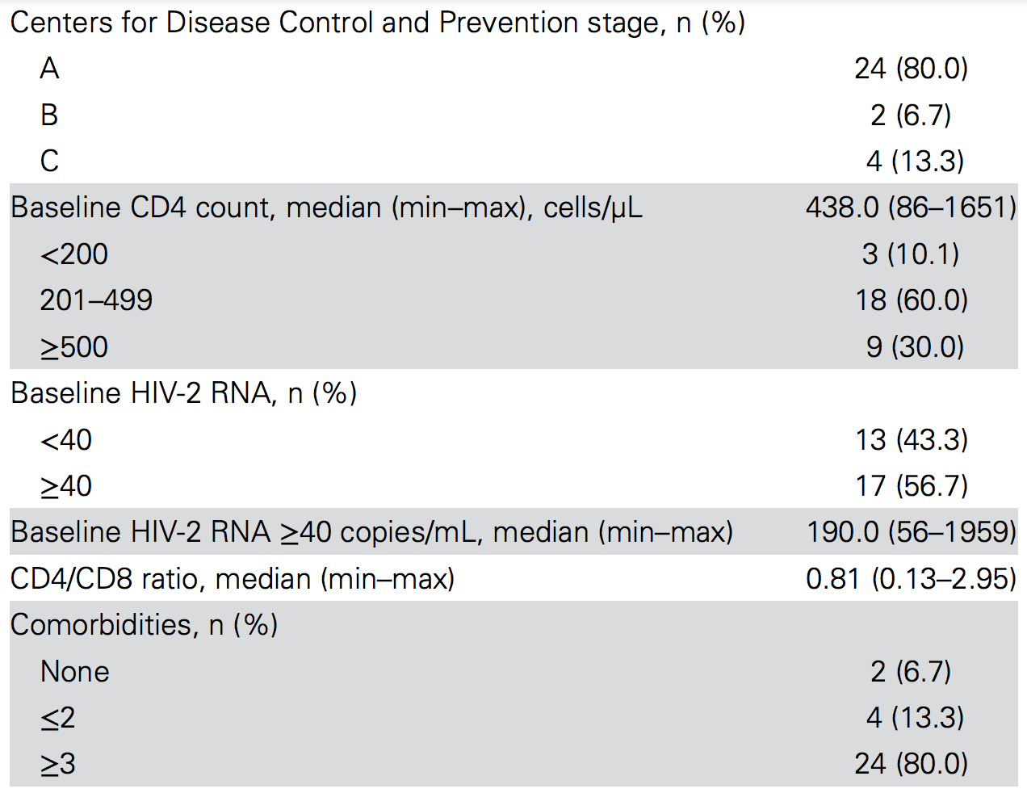
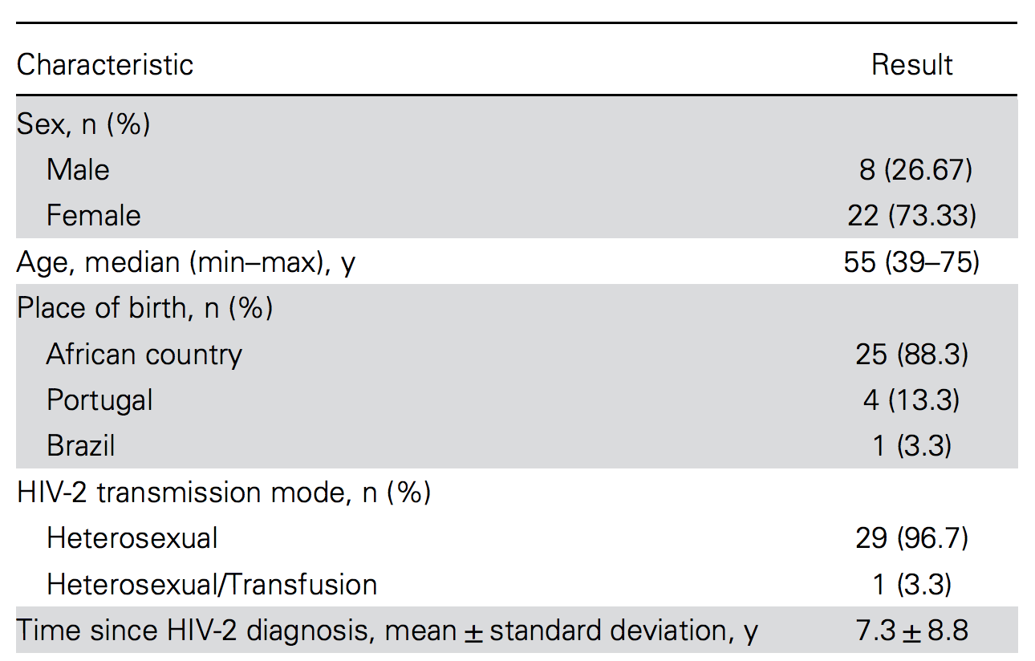
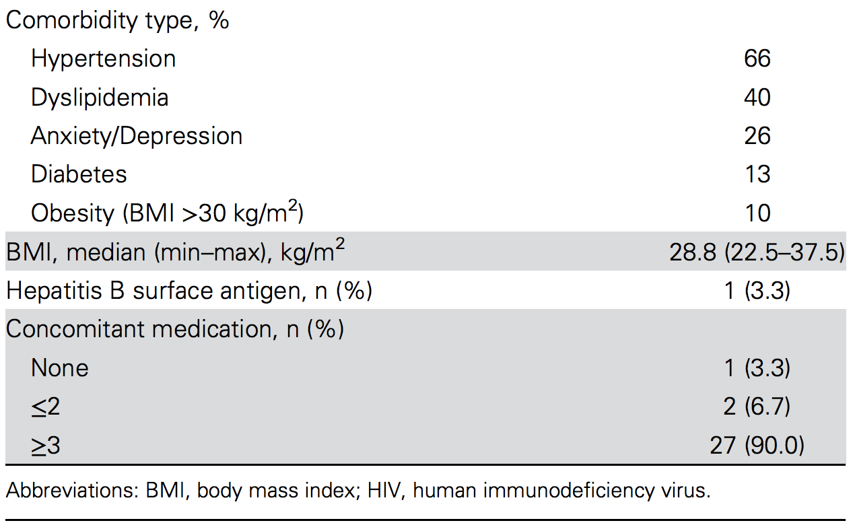
SAFETY AND EFFICACY OF DOLUTEGRAVIR BASED TRIPLE THERAPY IN HIV-2 INFECTION
RESULTS
Demographic and Baseline Characteristics (ITT)

Slide 12
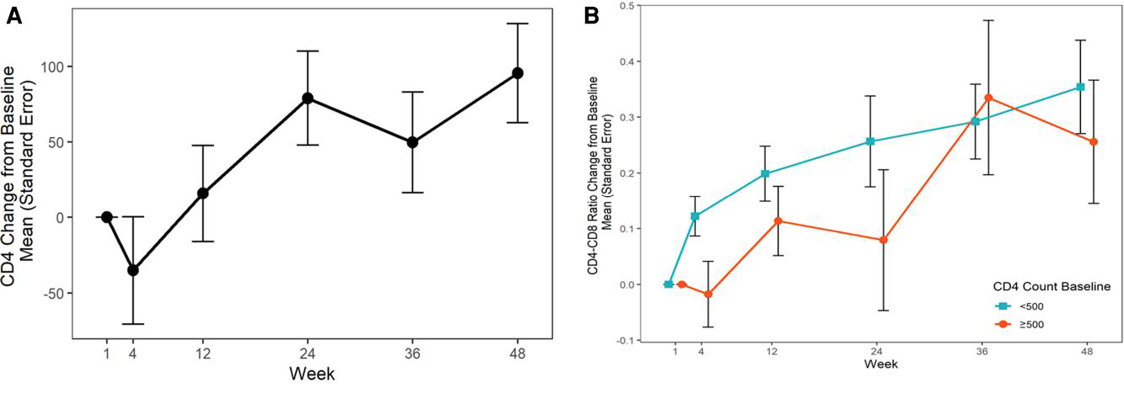
SAFETY AND EFFICACY OF DOLUTEGRAVIR BASED TRIPLE THERAPY IN HIV-2 INFECTION
RESULTS
Immunological response
Overall mean change from baseline in CD4 cell count:
95.6 cells/µL (95% CI, 28.1 to 163.1) at W48
Overall mean change from baseline in CD4/CD8 ratio:
0.32 (95% CI, 0.19 to 0.46) at W48
(A) CD4 and
(B) CD4/CD8 Ratio
mean change from baseline by CD4 count baseline in the per-protocol population
<500 cells/µL: 0.35 (95% CI, 0.18 to 0.53)
≥500 cells/µL: 0.26 (95% CI, 0.00 to 0.51)

Slide 13
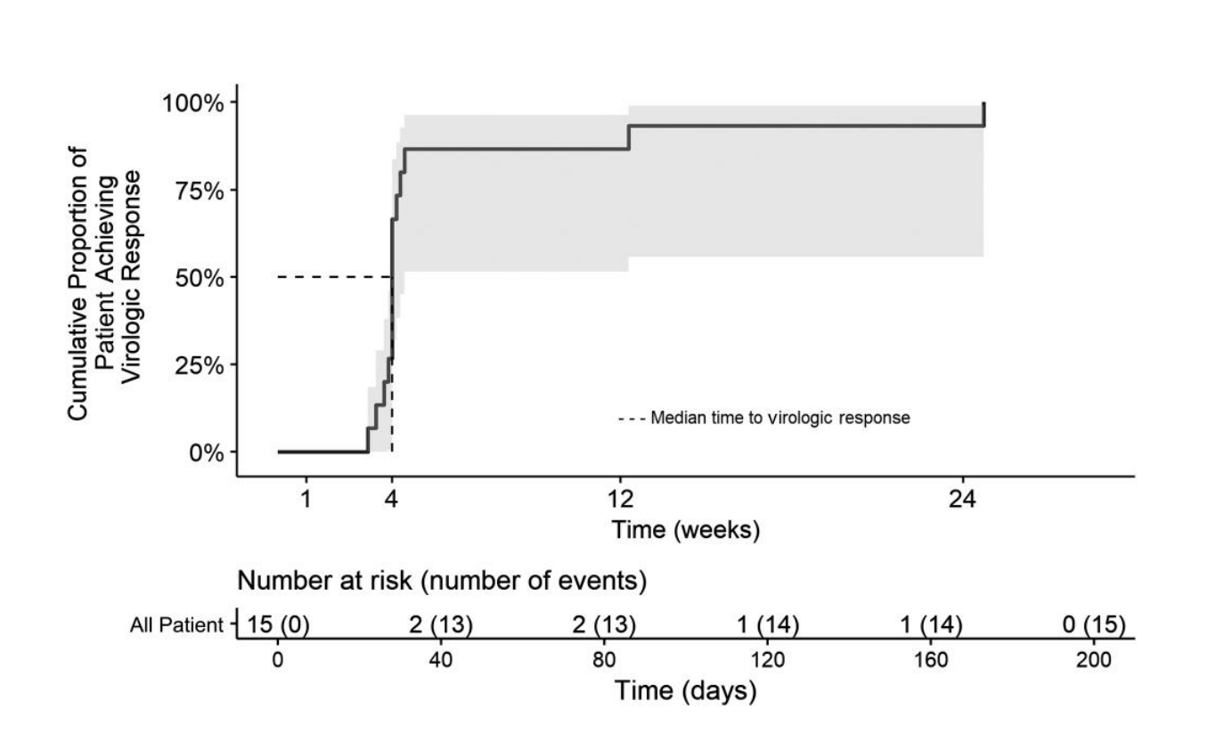
SAFETY AND EFFICACY OF DOLUTEGRAVIR BASED TRIPLE THERAPY IN HIV-2 INFECTION
RESULTS
Virologic response
All viremic patients achieved a pVL<40cp/mL at W24
The median time to virological response was 4 weeks.
None of the patients had loss of virological response during the 48 weeks of treatment.
Proportion of patients with plasma human immunodeficiency virus type 2 RNA <40 copies/mL from week 1 to week 24 in the per-protocol population.

Slide 14
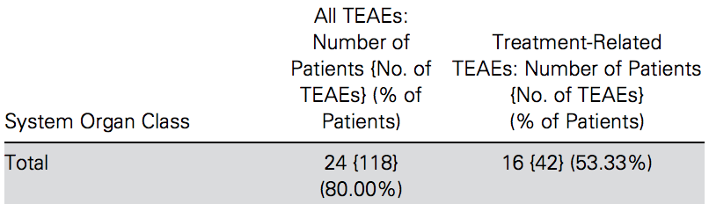
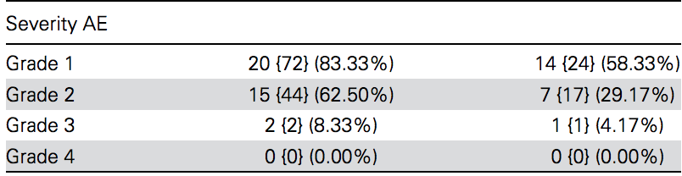
SAFETY AND EFFICACY OF DOLUTEGRAVIR BASED TRIPLE THERAPY IN HIV-2 INFECTION
RESULTS
Adverse events (AEs)
Grade 1 mild
Grade 2 moderate
Grade 3 severe
Grade 4 potentially life-threatening
42 AEs were considered to be drug-related
No serious AEs, deaths, or AIDS-associated clinical events were reported
TEAEs (≥ 10%)
One patient was discontinued from the study due to anxiety, insomnia, and memory impairment, which were considered drug-related
Abbreviation: TEAE, treatment-emergent adverse event
Notes:
Twenty-four of 30 patients who received the study treatment reported a total of 118 AEs, of which 42 AE were considered by the investigator to be drug-related

Slide 15
SAFETY AND EFFICACY OF DOLUTEGRAVIR BASED TRIPLE THERAPY IN HIV-2 INFECTION
CONCLUSIONS
Dolutegravir + 2NRTIs is safe and effective first-line treatment, by promoting a CD4 cell recovery comparable to other antiretroviral regimens already tested in HIV-2 infection
No virological failures suggesting a higher potency of DTG in HIV-2, as observed in HIV-1
From a global public health perspective, this study further supports the use of Tenofovir disoproxil/Lamivudine/Dolutegravir (TLD) in low- to middle-income countries with high prevalence of HIV-2, namely, West African countries
Notes:
This is the first trial to use a DTG-based regimen in first-line treatment of PWHIV-2.

Slide 16
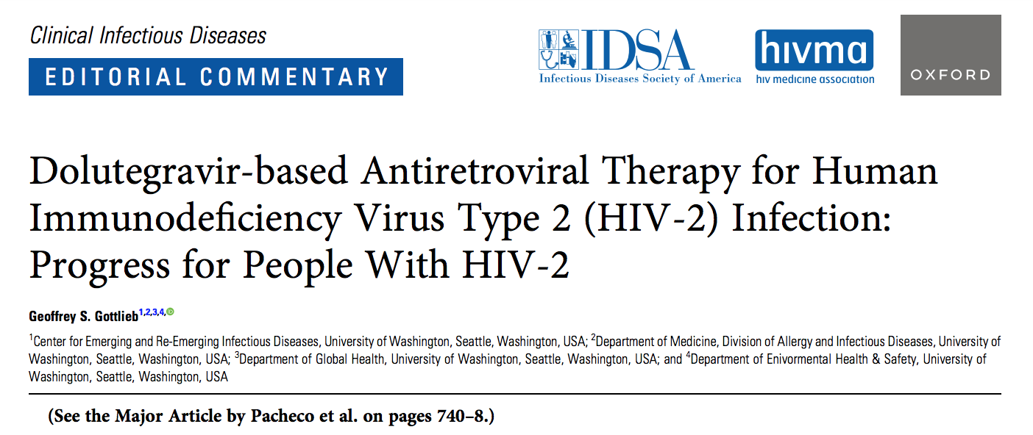

SAFETY AND EFFICACY OF DOLUTEGRAVIR BASED TRIPLE THERAPY IN HIV-2 INFECTION
"Overall, the trial by Pacheco and colleagues is an important step in providing further evidence that dolutegravir-based ART is safe and effective as initial treatment in PWHIV-2, and they should be commended on their efforts. "
Clinical Infectious Diseases® 2023;77(5):749–51

Slide 17
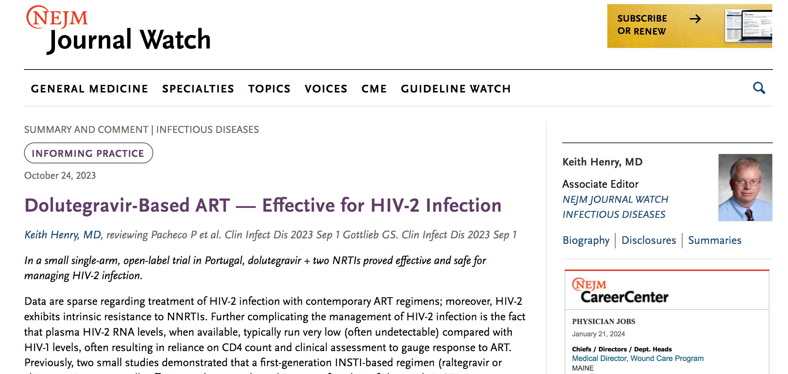

SAFETY AND EFFICACY OF DOLUTEGRAVIR BASED TRIPLE THERAPY IN HIV-2 INFECTION

Slide 18
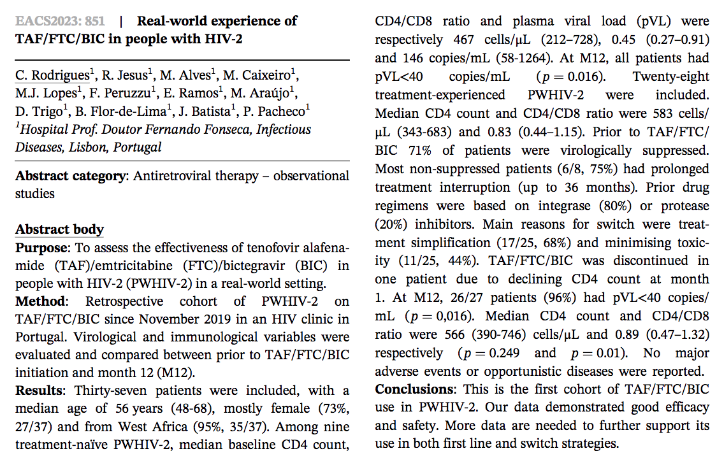
HIV-2 RESEARCH PLANS
Database solution for an HIV-2 cohort study
Publication "Real-world experience of TAF/FTC/BIC in people with HIV-2" presented at European AIDS Clinical Society Conference, Oct 2023, Warsaw
HIV-2 salvage therapy with Lenacapavir (injectable, capsid inhibitor, EMA approved 2022)

Slide 19
SAFETY AND EFFICACY OF DOLUTEGRAVIR BASED TRIPLE THERAPY IN HIV-2 INFECTION
RESULTS FROM A 48-WEEK PHASE 2 STUDY
Patrícia Pacheco, Nuno Marques, Paulo Rodrigues, Kamal Mansinho, Fernando Maltez, Nuno Janeiro, Cláudia Franco, Diva Trigo, Joana Batista, Luís Duque,
Maria João Lopes, Maria João Aleixo, Ana Rita Silva, Raquel Tavares, João Alves, Susana Peres, Diana Póvoas, Sara Lino, Perpétua Gomes, Vânia Araújo, Cristina Lopes
PRÉMIO CIENTÍFICO
HOSPITAL PROFESSOR DOUTOR FERNANDO FONSECA
Edição 2023
Maria João Lopes
Assistente Hospitalar de Doenças Infecciosas - Serviço de Infecciologia
30 Janeiro 2024

Slide 20
